Slide 1
Verification & Validation Workshop: Gaining confidence in your design
4-5 November 2015
Chuck Olosky Application Engineer
Nathan Crosty Application Engineer
Bill Maher Account Manager

Slide 2
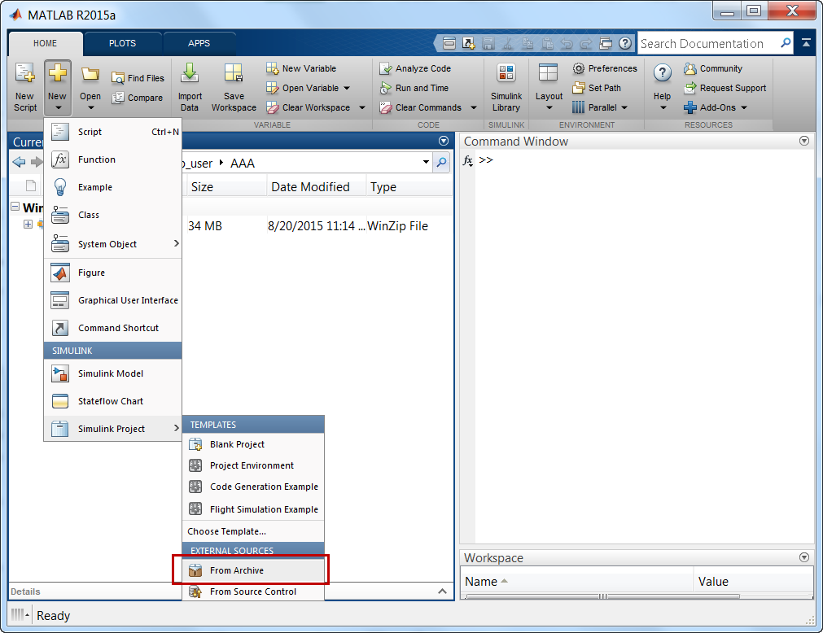
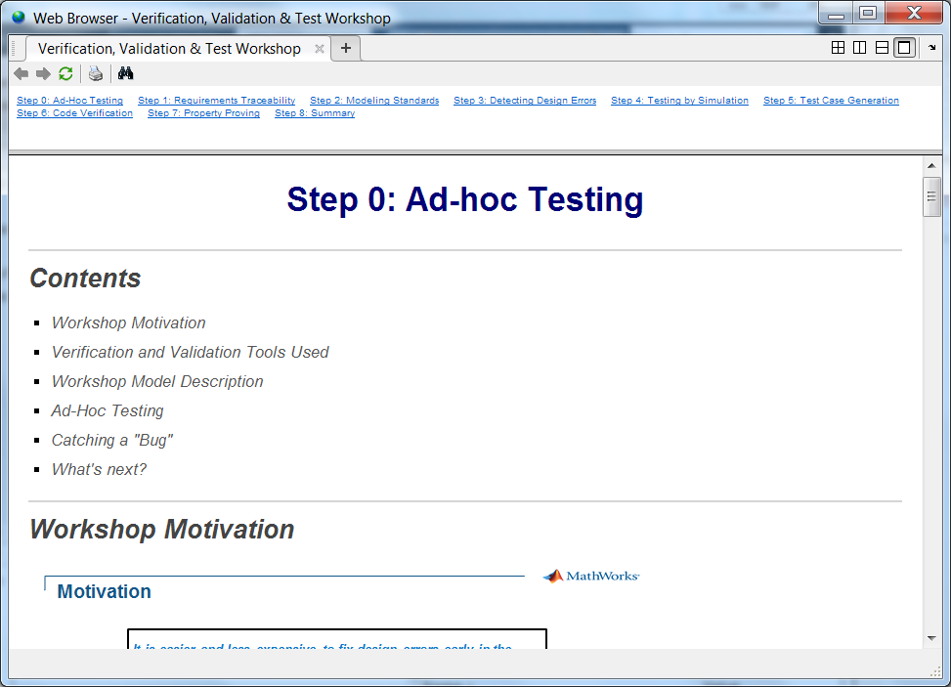
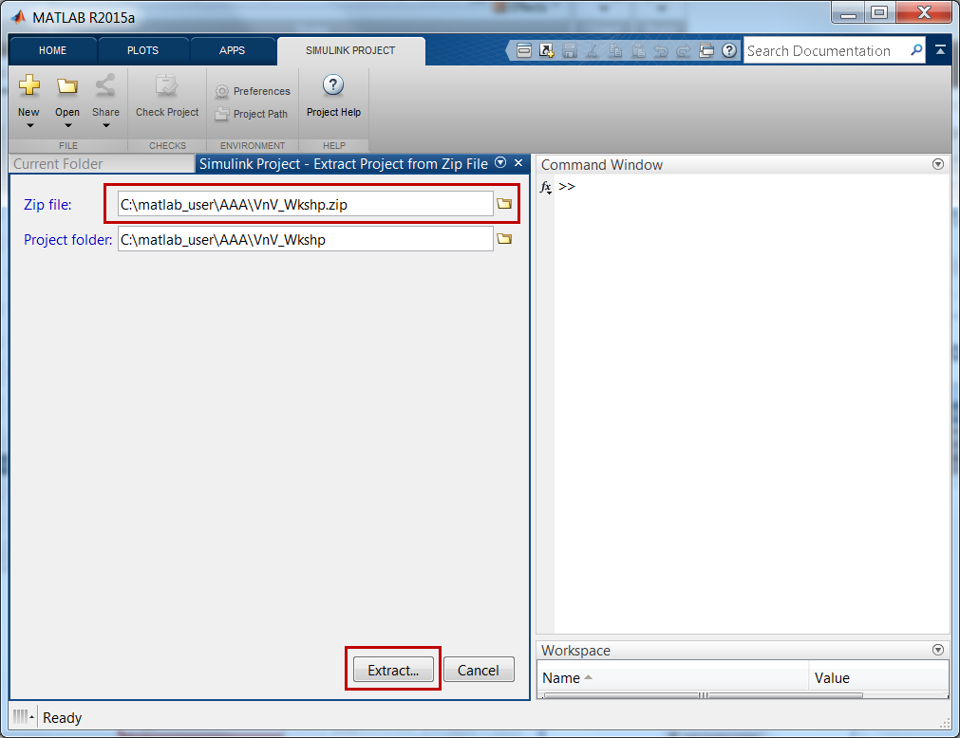
Importing & Opening V&V Workshop Project
Copy zip file
Open MATLAB
Navigate to directory
New → Simulink Project →From Archive
Select zip file
Extract

Slide 3
Motivation
It is easier and less expensive to fix design errors early in the process when they happen.
We will talk about ….
How Model Based Design (MBD) facilitates early testing to incrementally increase confidence in your design
Usage of V&V tools to enable delivery of higher quality software throughout the workflow
Integration of V&V testing with code generation to improve confidence in the work product

Slide 4
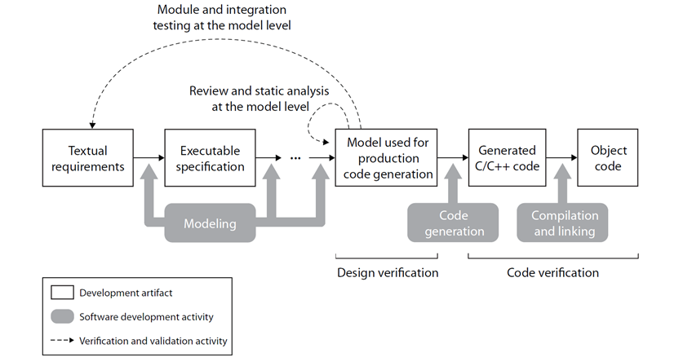
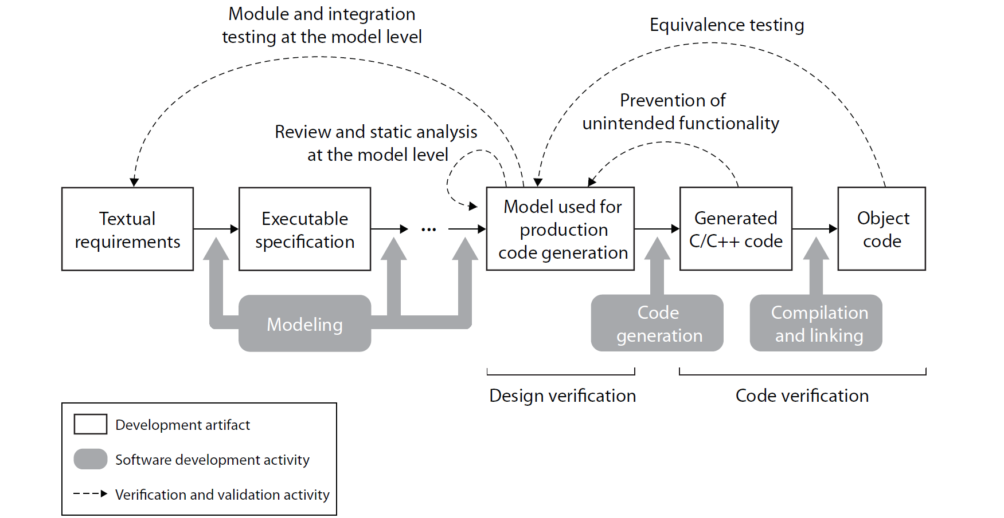
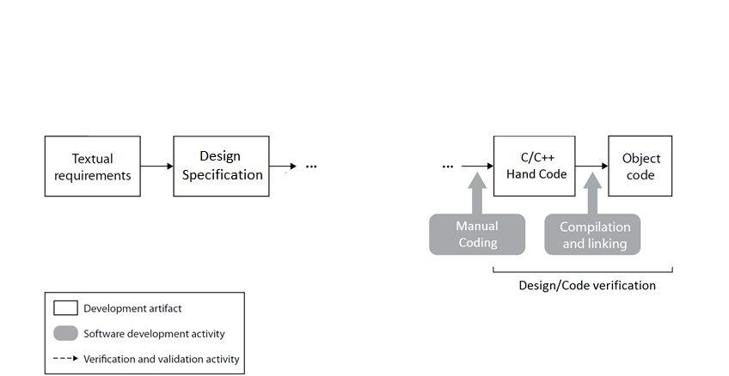
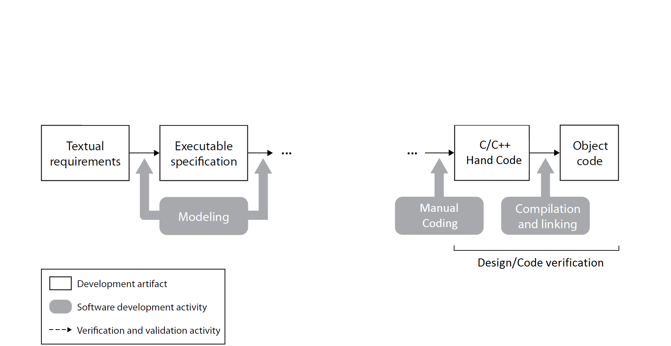
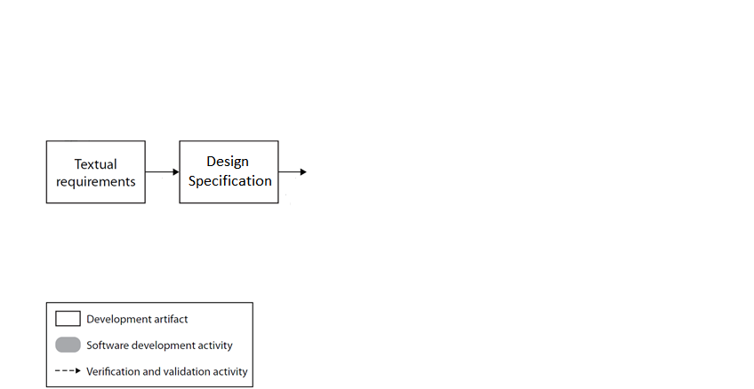
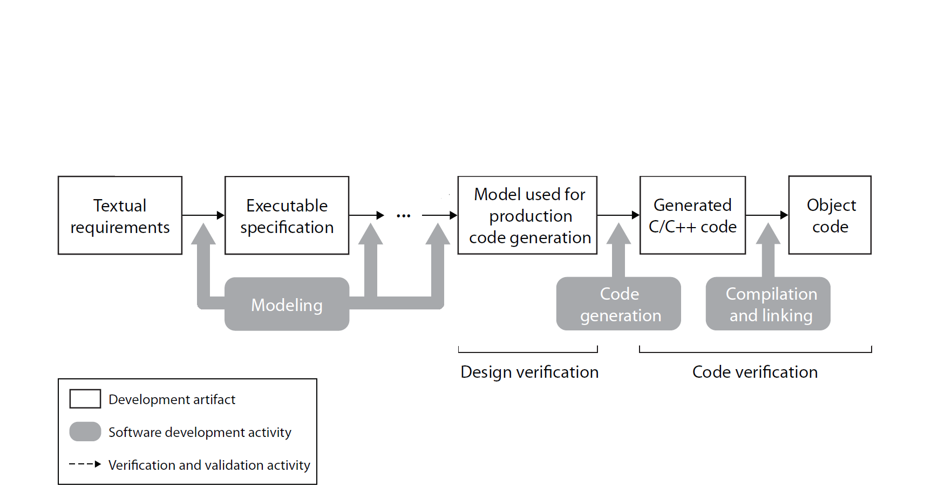
Model Based Design Workflow
Model Verification
Code Verification
Discover design errors at design time
Gain confidence in the generated code

Slide 5
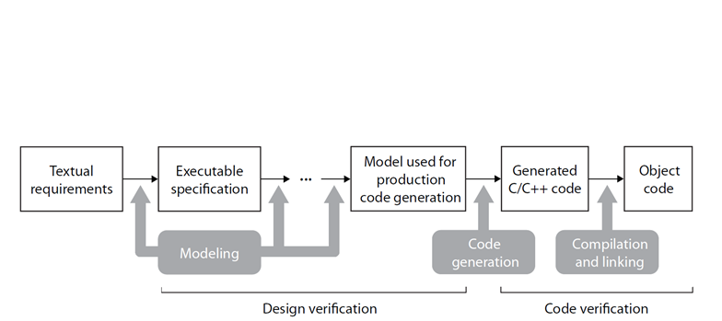
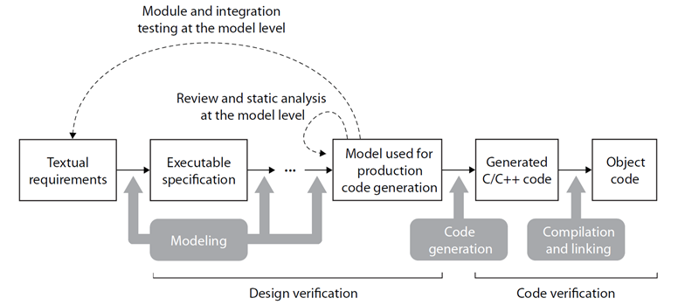
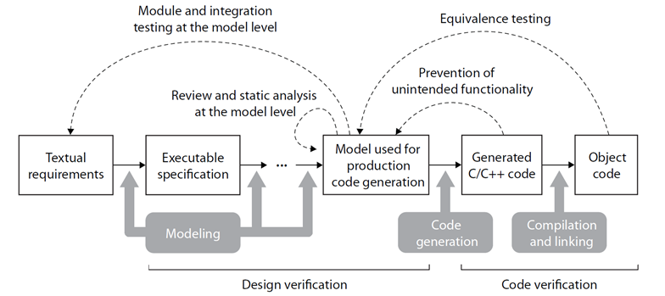
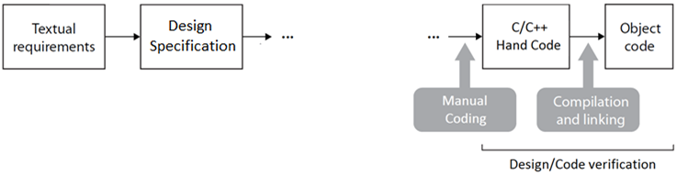
Model Based Design Verification Workflow
Model Verification
Code Verification
Discover design errors at design time
Gain confidence in the generated code

Slide 6

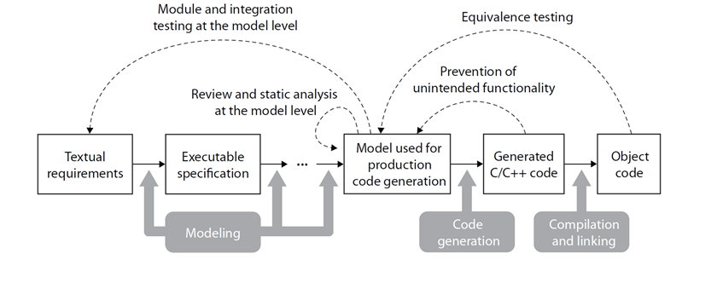
Model Verification Tools
Ad-hoc Testing
Simulink
Traceability
SLV&V
Model Standards
SLV&V
Design Error Detection
SLDV
Testing by Simulation with Model Coverage
SLV&V
Property Proving
SLDV
Model Verification
Discover design errors at design time
Simulink,
Requirements Mgmt Interface (SLV&V)
Model Coverage (SLV&V)
Model Advisor (SLV&V)
Design Error Detection (SLDV)
Property Proving (SLDV)
Simulink, Stateflow, Simulink Fixed Point

Slide 7
Code Generation & Verification Tools
Code Verification
Gain confidence in the generated code
Traceability Report
SLV&V
Embedded Coder
Test Vector Generation
SLDV
Equivalence Testing
Simulink (SIL/PIL)
Embedded Coder
3rd Party Code Coverage Tool
Traceability report (Embedded Coder),
Bullseye code coverage (Embedded Coder)
Test vector generation (SLDV),
SIL/PIL testing / CGV (Embedded Coder)
Embedded Coder

Slide 8
V&V Workshop Goals
Implement a V&V workflow to deliver controls with high design confidence
Develop test assets for use and re-use
Enforce modeling standards
Document traceability of requirements to design models
Show the absence of design errors
Demonstrate the design meets requirements with simulation testing
Confirm the generated code behavior matches the model
Prove the design meets requirements over the operating ranges

Slide 9
V&V Workshop Agenda – Day 1
Introduction and 9:00-9:15
MBD V&V Overview
Ad-hoc Testing 9:15-9:30
Performing informal functional checks
Instrumenting the model
Requirements Traceability 9:30-10:00
Linking requirements to Simulink model objects
Generating a requirement traceability report
Modeling Standards 10:00-10:30
Performing static analysis using Model Advisor
Customizing Model Advisor
Break 10:30-10:45
Detecting Design Errors 10:45-11:15
Analyzing the model for unreachable logic
Finding divide by zero issues
Testing by Simulation 11:15-12:45
Creating and using test harness models
Entering input and expected output test vectors
Collecting model coverage from functional test cases
Generating test report
Summary – Q&A Discussion 12:45-13:00

Slide 10
V&V Workshop Agenda – Day 2
Introduction and 9:00-9:15
Day 1 Summary
Test Case Generation 9:15-9:50
Generating test cases for missing model coverage
Merging generated test cases with existing test cases
Code Verification 9:50-10:20
Using the code generation report for traceability
Performing equivalency tests with SIL mode
Collecting code coverage in SIL mode (optional)
Break 10:20-10:30
Property Proving 10:30-11:15
Modeling requirements as properties
Performing property proving to verify requirements
Summary – Q&A Discussion 11:15-11:30

Slide 11
Workshop

Slide 12
Model Verification Summary
Requirements Traceability
Requirements linking to blocks, states, transitions, MATLAB code
Navigation and reporting of Requirements ←→ Model
Enforcing Model Standards (Static Testing)
Automated model checking with standard or custom checks
Interactive fixing workflow with reports for model reviews
Design Error Detection
Automated, static check for divide by zero, overflow, dead logic
Increase confidence in the design
Requirements based Functional Testing
Automated creation of test harnesses and entry of test vectors
Model coverage analysis to show design & test completeness
Property Proving
Model requirements with property blocks
Attempt to violate property to demonstrate robustness
Earlier testing to deliver higher quality software throughout the workflow

Slide 13
Code Verification Summary
Traceability
Code generation report
Complete traceability: Requirements ←→ Model ←→ Code
Test Vector Generation
Increase coverage beyond requirements testing
Complete model coverage for equivalence testing
Equivalence Testing
Re-use of high coverage model test vectors in SIL mode
Automated SIL testing, save to Simulation Data Inspector
Model vs Code output comparison
Unintended Functionality
Re-use of high coverage model test vectors in SIL mode
Integrated 3rd party code coverage tool
Results in code generation report
Model vs Code coverage comparison
Confidence in work product by re-using Model Verification test harnesses in an automated workflow

Slide 14
Agenda
Gaining confidence in your design with traditional functional testing and coverage
Uncovering hard-to-find design errors like dead logic, divide by zero and integer overflows
Gaining confidence in your design using model based formal testing methods (optional)
Prove implementation will meet requirements
Minimize the possibility of unintended behavior
Reproduce field issues and identify failure modes
The products shown will include
Simulink Verification and Validation – Model Coverage, Req Linking, Model Advisor
Simulink Test – Functional Testing
Simulink Design Verifier – Design Error Detection and Property Proving

Slide 15
How did we get here?
We will show ….
The MBD testing before running it in the vehicle
How the test results were used to identify and fix bugs
How we increased confidence in our controls design
How we thought it was ready for vehicle testing
Notes:
NEED TO HIGHLIGHT relevant parts of email. Ask question to room …
Shaun: More “feeling”…. Use an email from Chuck (Snagit)… does this happen to you guys ….
Jay: Chuck: Can we start with this…
Use pic of chuck.

Slide 16
Motivation
It is easier and less expensive to fix design errors early in the process when they happen.
We will talk about ….
How Model Based Design (MBD) facilitates early testing to incrementally increase confidence in your design
Usage of V&V tools to enable delivery of higher quality software throughout the workflow
Integration of V&V testing with code generation to improve confidence in the work product

Slide 17
Demo Informal testing: Ad-hoc Testing

Slide 18
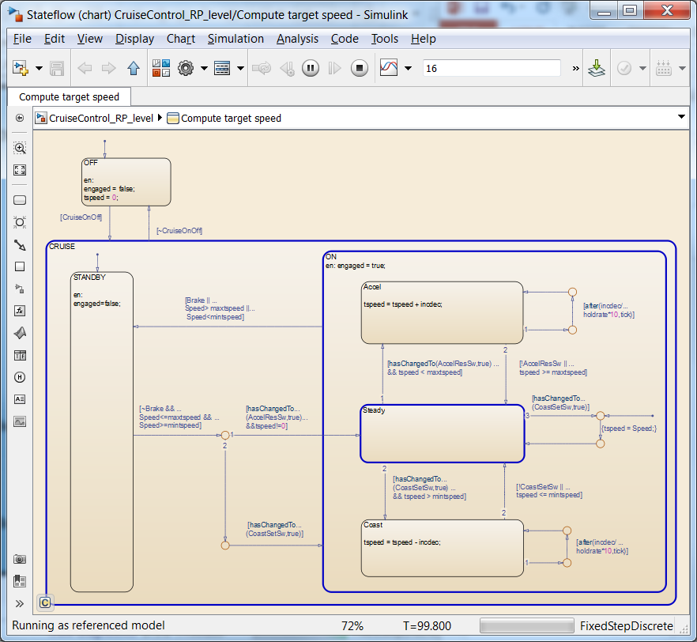
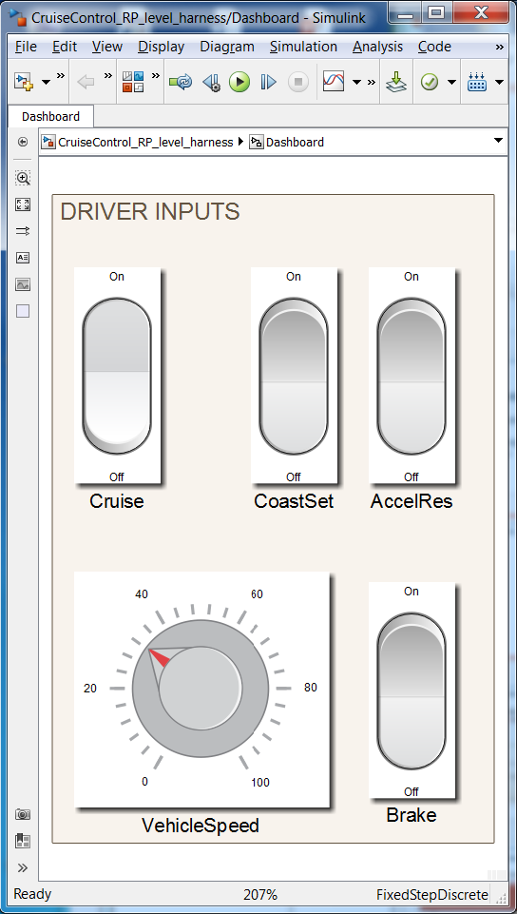
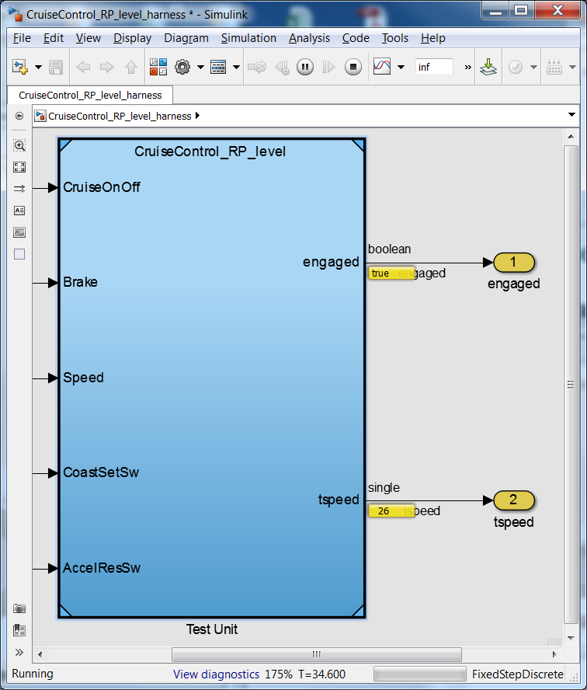
Ad-hoc Testing
New “Dashboard” blocks facilitate early ad-hoc testing
Notes:
Range of calibration constraints

Slide 19
Increasing Confidence beyond Ad-hoc Testing
Ad-hoc testing is a very useful method but what else do we need to check?
Are all requirements implemented?
Does the implementation follow modeling standards?
Have we shown the absence of design errors (dead logic, divide by zero, overflow)?
Does the implementation pass all functional requirements?
Do the tests completely exercise the implementation?
Does the generated code behave the same as the model?
Can we prove the implementation always meets requirements?
Notes:
NEED TO HIGHLIGHT relevant parts of email. Ask question to room …
Shaun: More “feeling”…. Use an email from Chuck (Snagit)… does this happen to you guys ….
Jay: Chuck: Can we start with this…
Use pic of chuck.

Slide 20
Gaining Confidence in our Design
Code equiv & integration checks
Field tests
Functional & structural tests
Confidence
Design error detection
Req Linking
Mdl Advisor
Effort / Time

Slide 21
Gaining Confidence in our Design
Code equiv & integration checks
Field tests
Functional & structural tests
Confidence
Design error detection
Ad-hoc tests
Effort / Time

Slide 22
Demo Model testing before code generation: Ad-hoc Testing

Slide 23
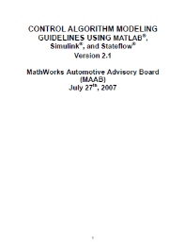
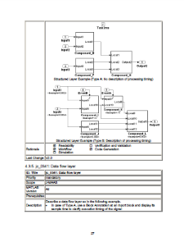
Modeling Guidelines
MAAB Style Guides
First version released in April, 2001
Collaboration by industry leaders in US, Japan, Europe: GM, Ford, Chrysler, Toyota, Daimler, John Deere, Delphi, Ricardo and others
Modeling Guidelines for High-Integrity Systems
Leverage industry-best practices and MathWorks tool expertise when developing high-integrity systems
ISO 26262, IEC 61508, DO-178B/C, and MISRA-C

Slide 24
Demo Static checks: Requirements Linking Model Advisor

Slide 25
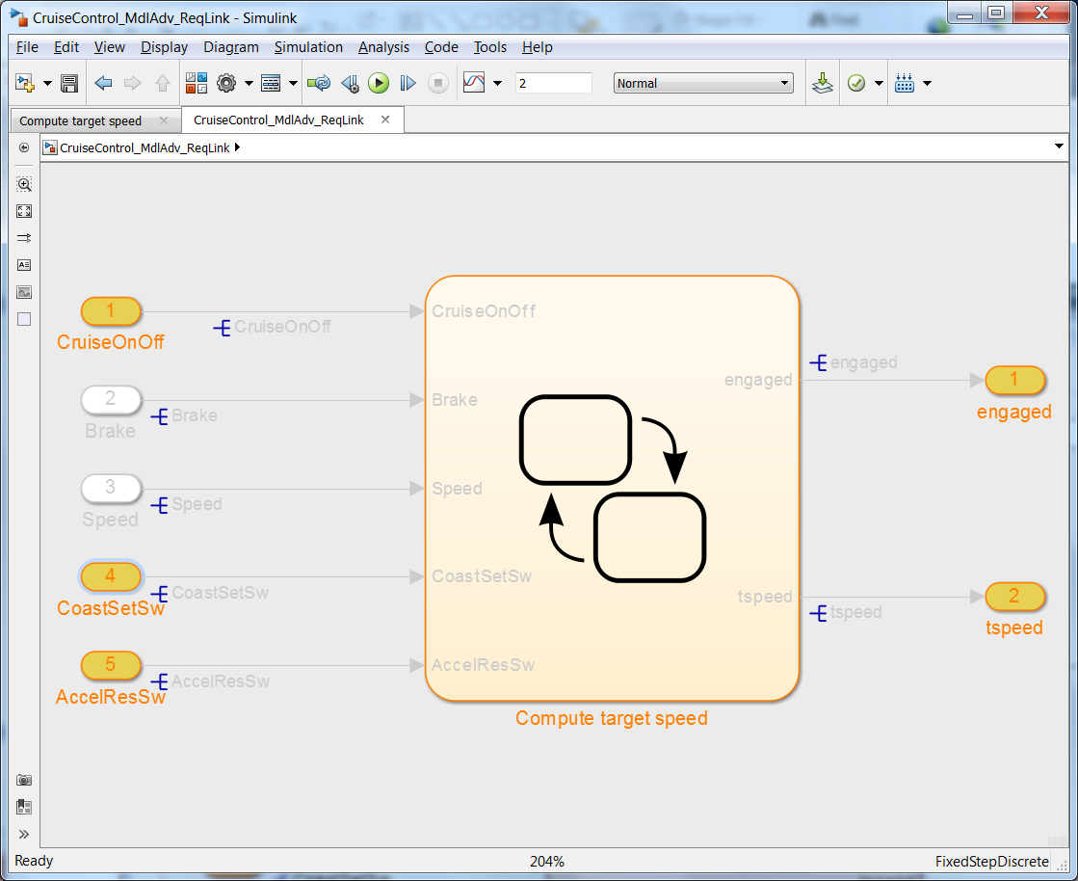
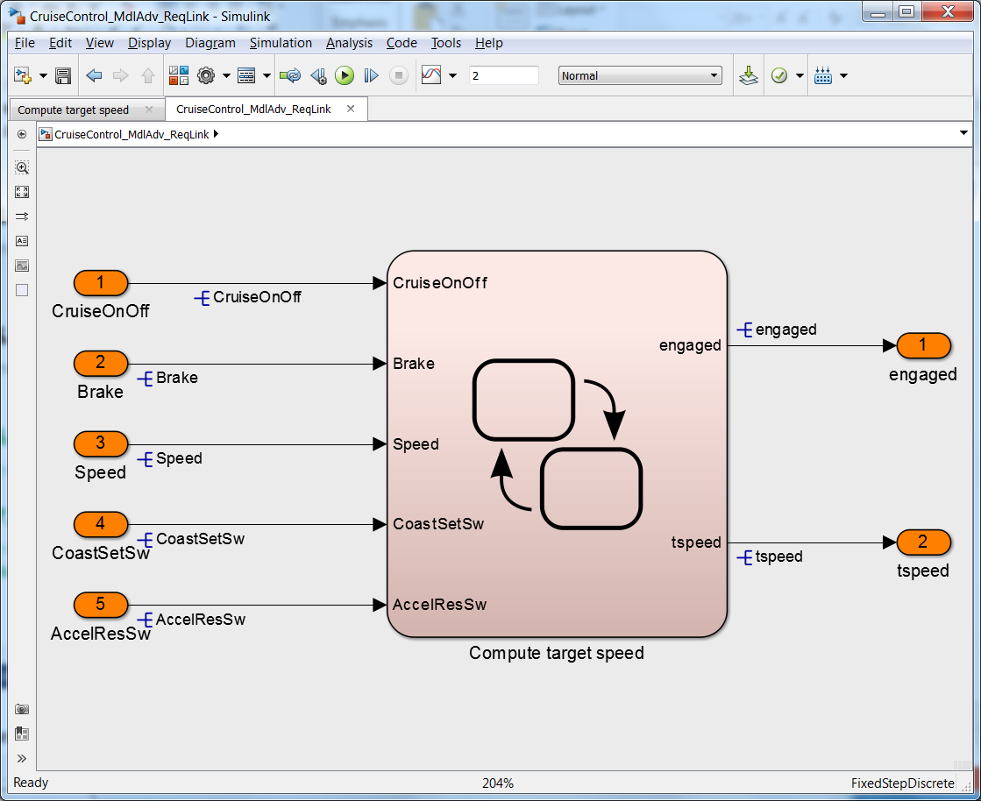
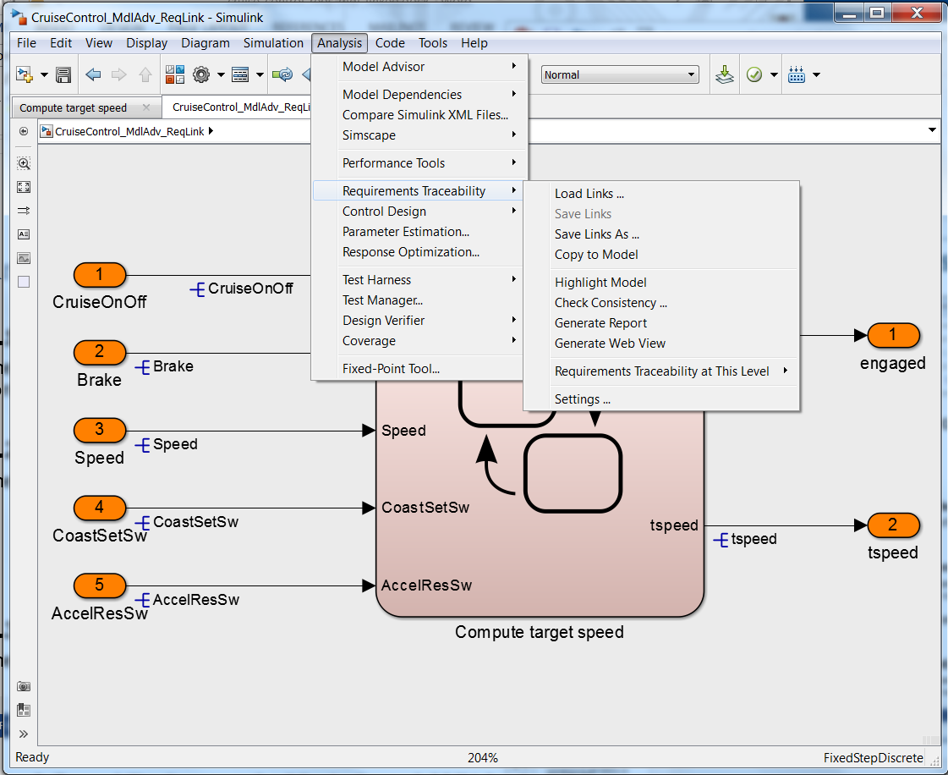
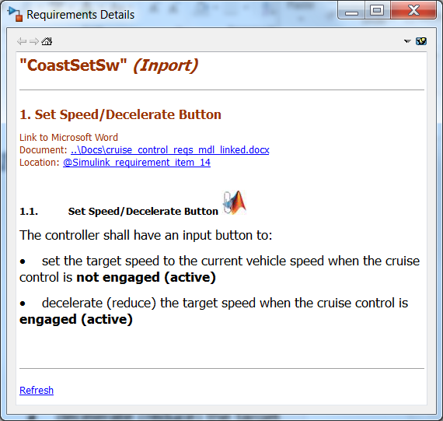
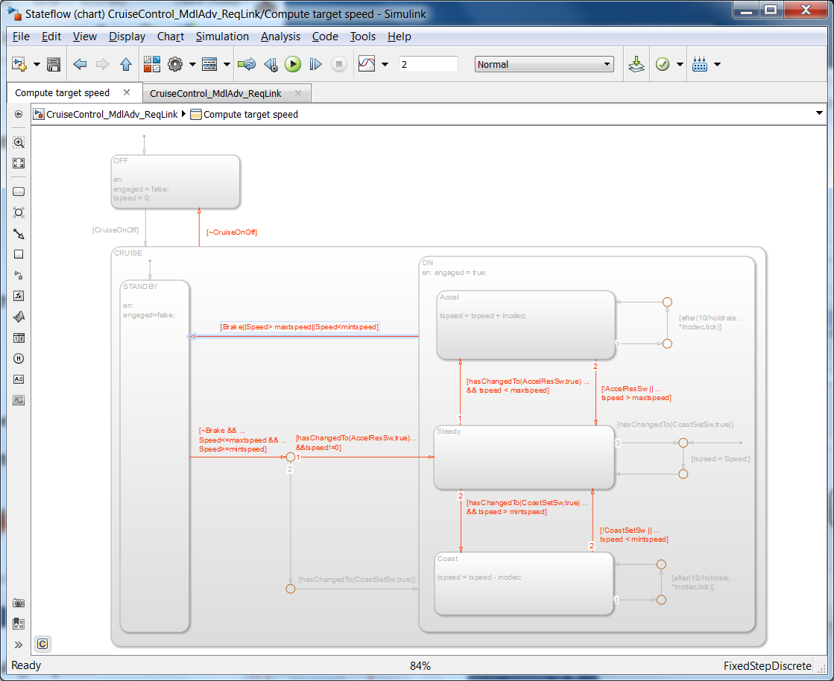
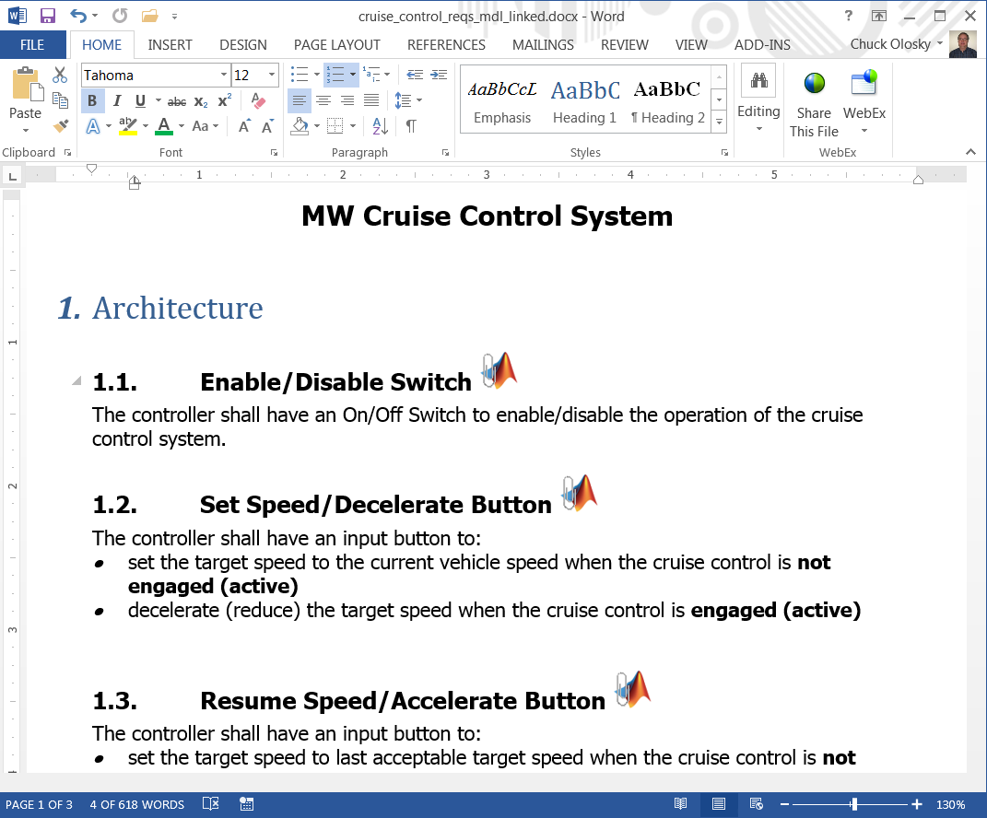
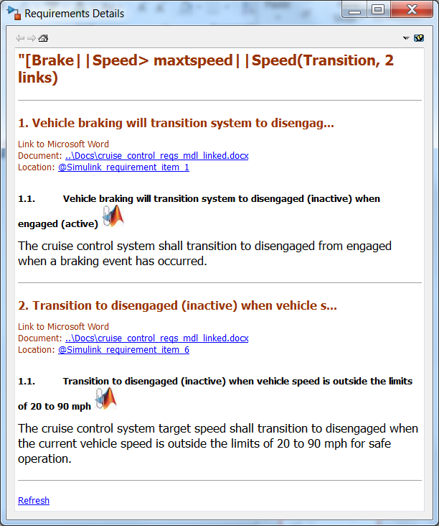
Requirements Linking – Highlighting Objects with Links
Notes:
Range of calibration constraints

Slide 26
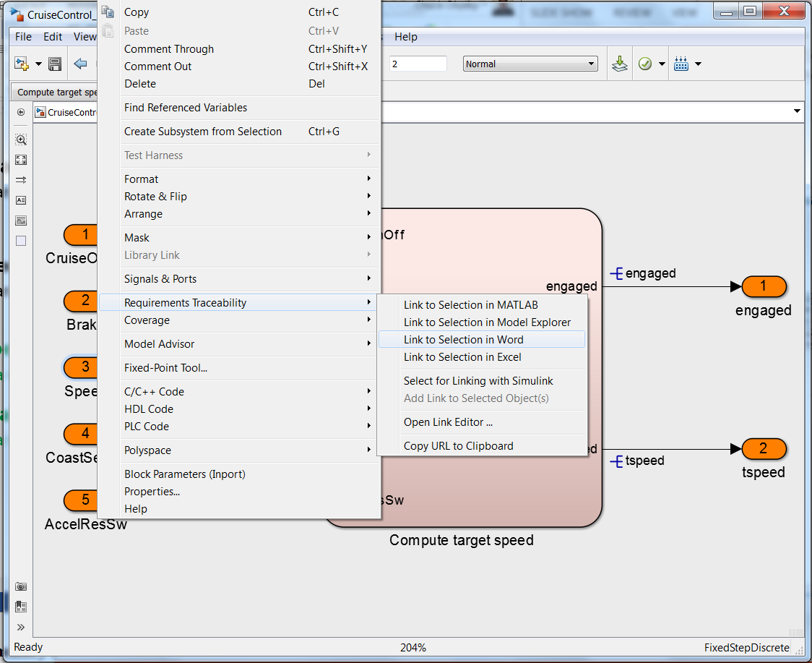
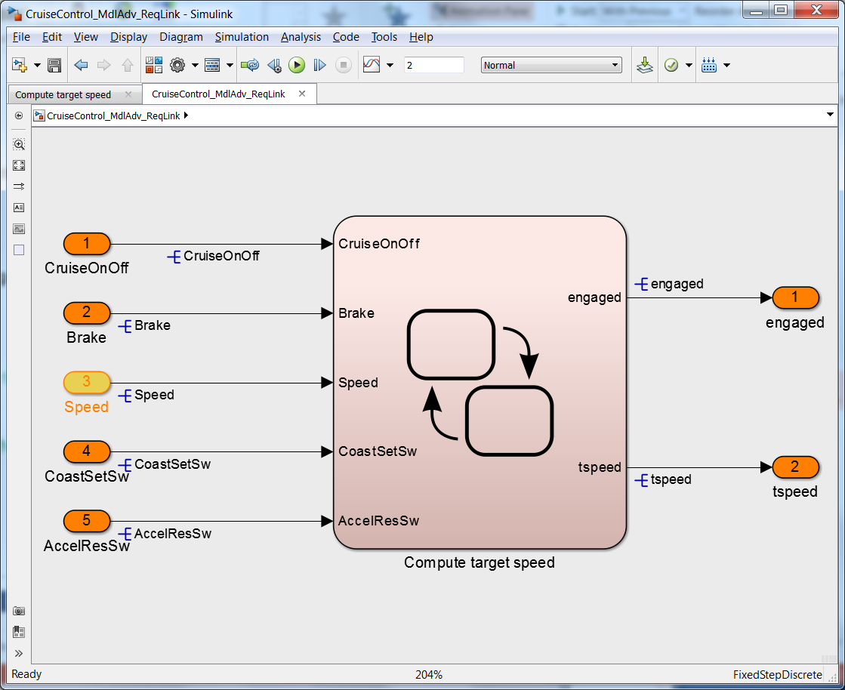
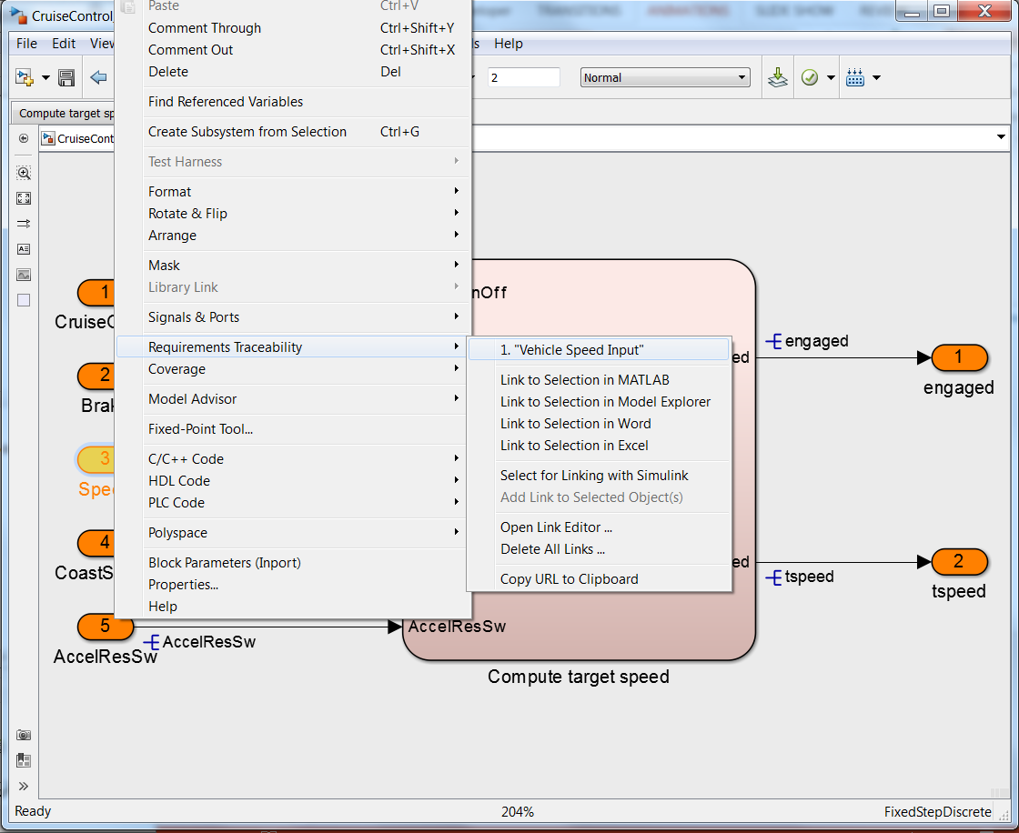

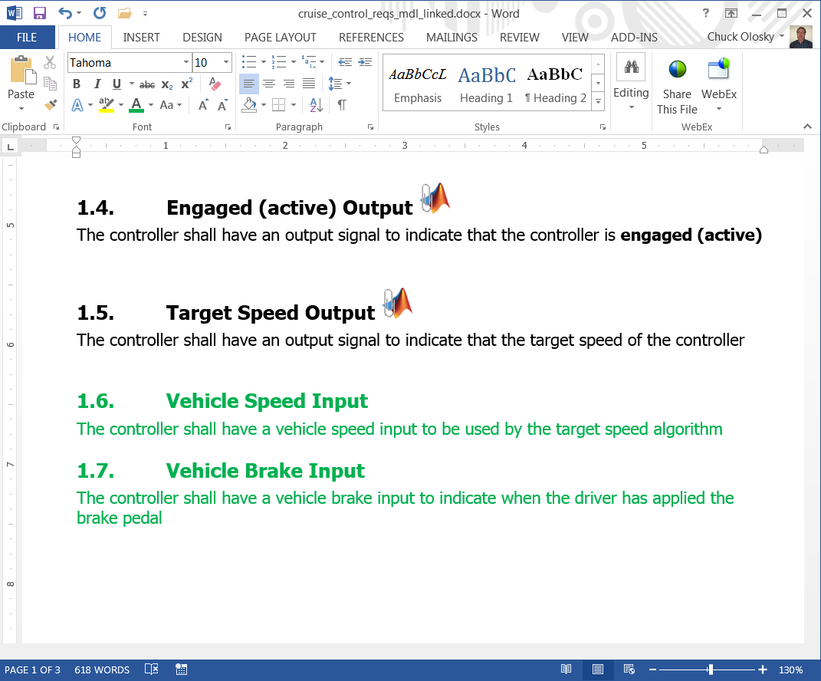
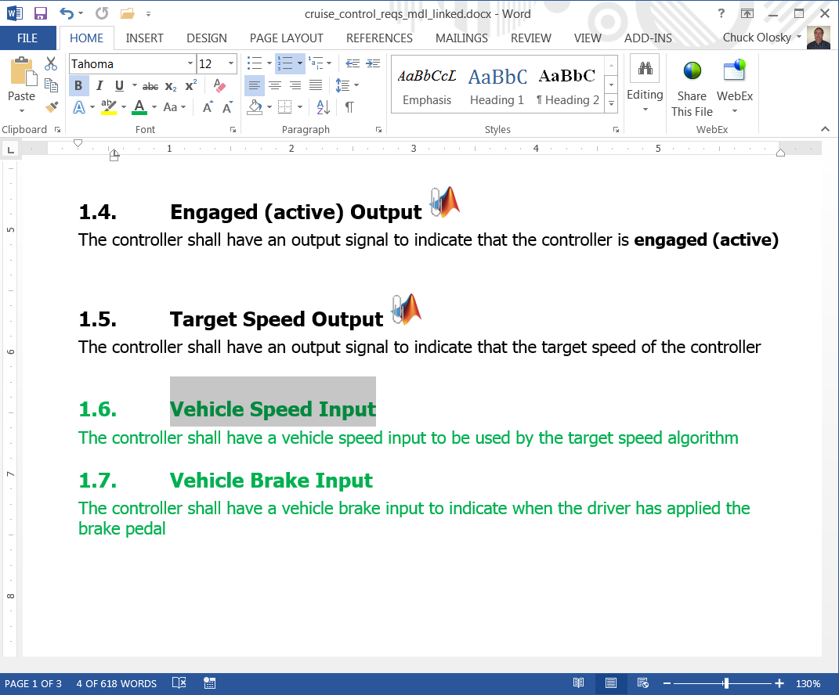
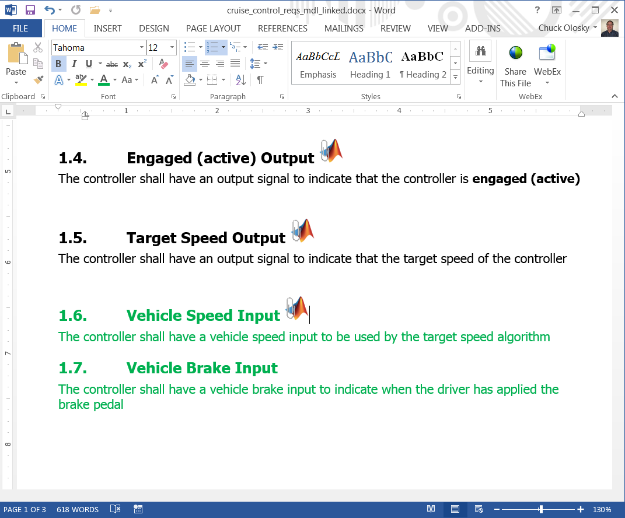
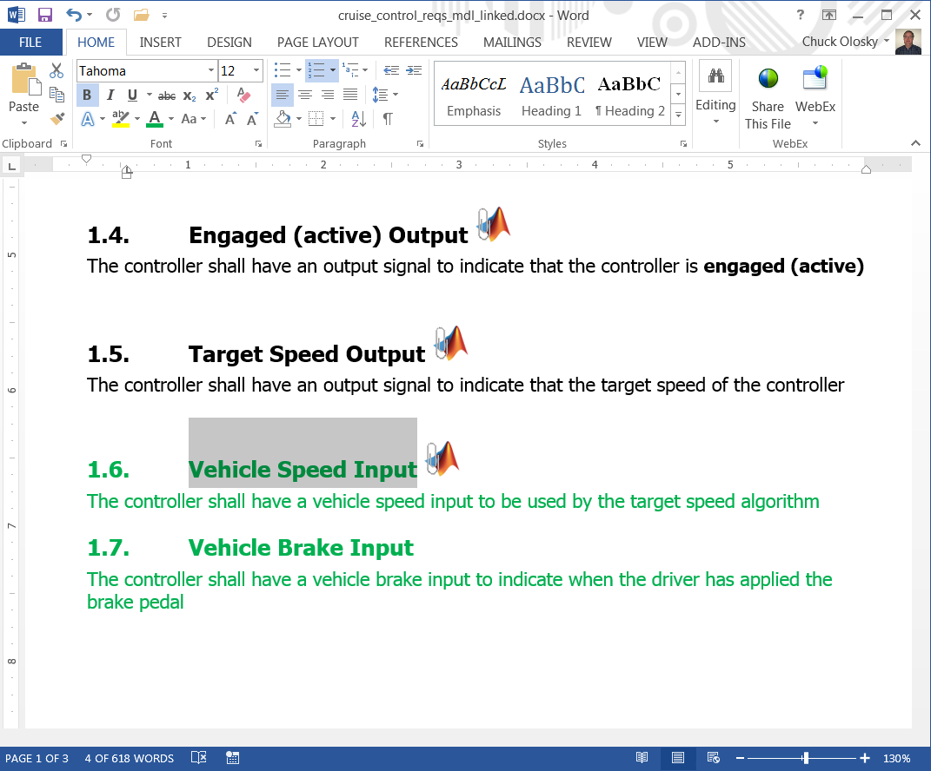
Requirements Linking – Adding New Links
Notes:
Range of calibration constraints

Slide 27
Traceability: Requirements Management Features
Link to objects in Simulink, Stateflow and Embedded Matlab
Requirements consistency checking
Bi-directional linking with external documents
API for process customization
Report generation
Link to these supported documents, not just requirements
Telelogic DOORS®
Microsoft Word ®
Microsoft Excel ®
PDF
HTML
Text
3rd party requirements vendors have a plug-in connector
Integrity
Polarian
Notes:
“Um das gesehene zusammenzufassen […]”
“Wer nutzt denn andere Anforderungsmanagementsysteme?” “Welches?”
=> “Dafür haben wir die Schnittstelle offengelegt und dokumentiert, sie können dies selber umsetzen oder unser Consulting beauftragen.”

Slide 28
Modeling Guidelines
MAAB Style Guides
First version released in April, 2001
Collaboration by industry leaders in US, Japan, Europe: GM, Ford, Chrysler, Toyota, Daimler, John Deere, Delphi, Ricardo and others
Modeling Guidelines for High-Integrity Systems
Leverage industry-best practices and MathWorks tool expertise when developing high-integrity systems
ISO 26262, IEC 61508, DO-178B/C, and MISRA-C

Slide 29
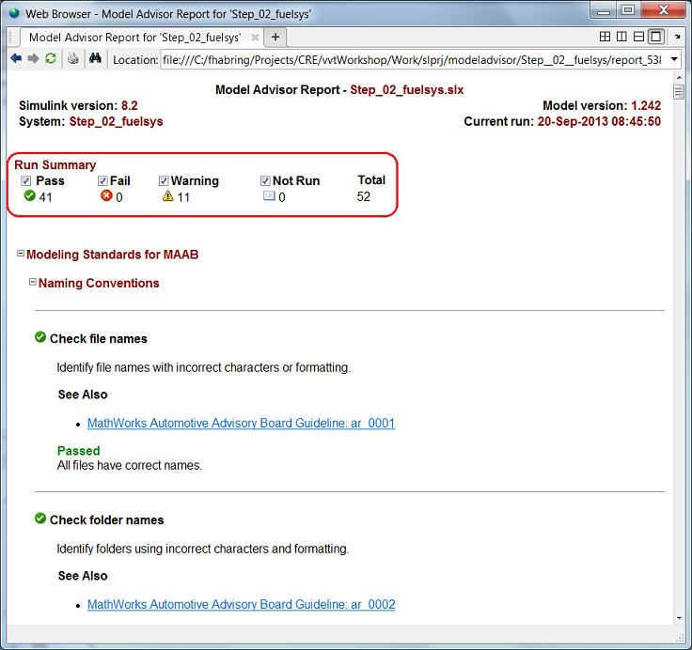
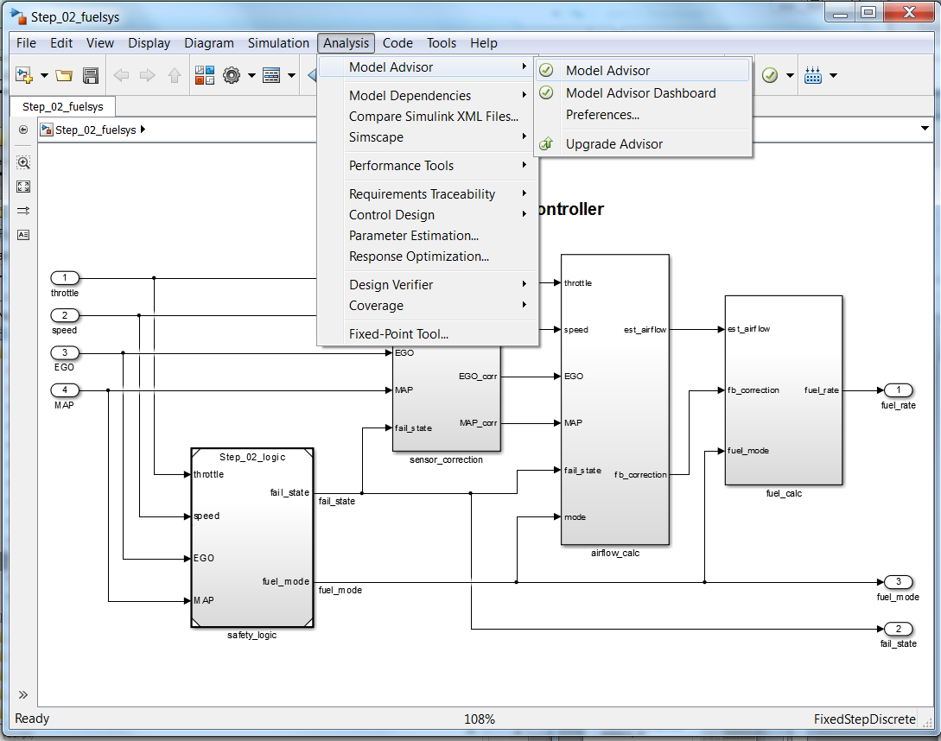
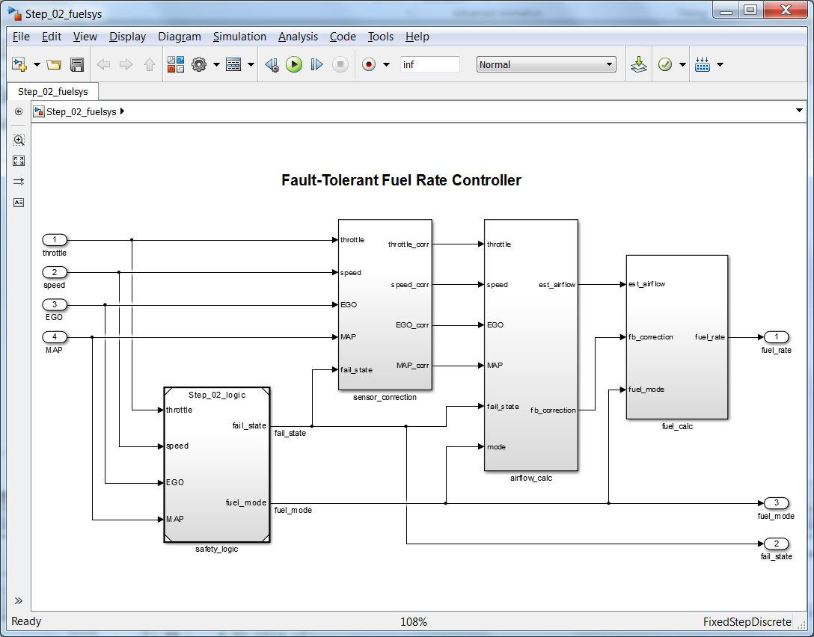
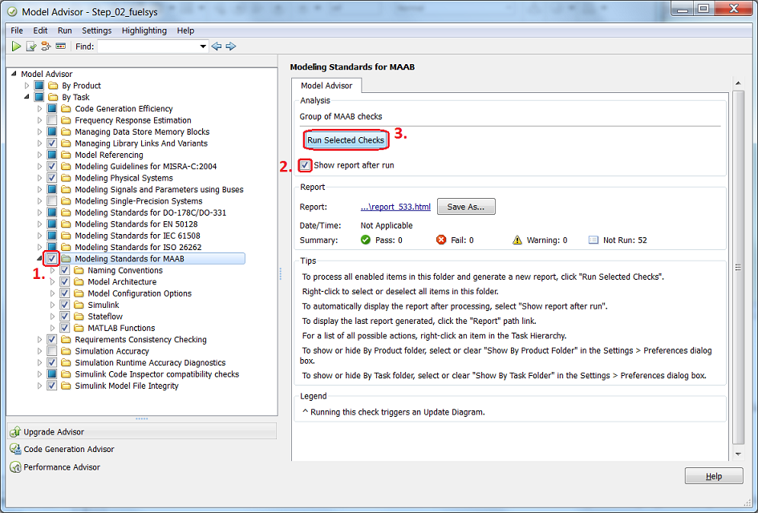
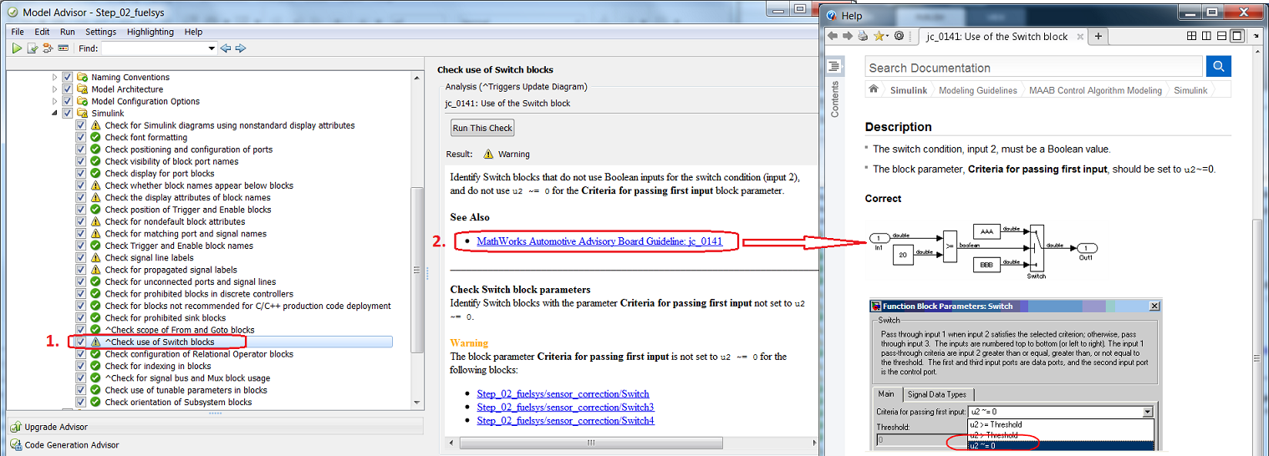
Model Advisor – Model Standards Checking
Notes:
Modeling standards are established either within several industry vendors, or within an organization, or a project. The goal of modeling standards checking is to automate some of the tedious reviews and to prevent problems from being introduced in the model in the first place. An example of a modeling standard is MAAB Style Guidelines document that has just been released in the second major version <link to the homepage if internet connection available)
In a way static checking is a best practice that should be applied on all artifacts you are going to exchange with other development groups, customers, or suppliers, very much like all professional documents and email correspondence should be spellchecked before being sent out.
Simulink Verification and Validation ships with a set of checks that cover a number of MAAB Style Guidelines and as of 2007B also a set of checks for conformance with the DO-178B Guidelines. Also important to mention is the API that allows you to build a set of custom checks and register them with Model Advisor.

Slide 30
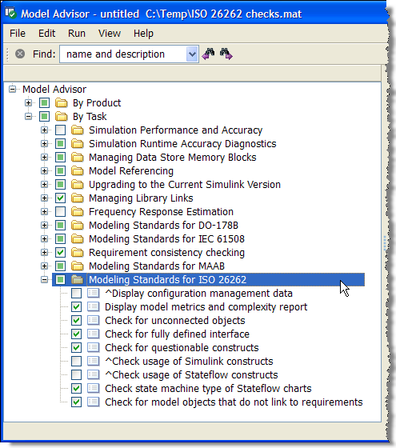
Enforcing Modeling Standards: Model Advisor Features
Static analysis of models against a set of checks
Checks for simulation configuration
Checks for code generation configuration
Requirements consistency
Modeling Standards
Modeling Standards Checks (SLVNV)
MAAB Style Guidelines
DO-178B
IEC 61508 and ISO 26262 checks
API for process customization
Create custom checks and configurations
Notes:
Modeling standards are established either within several industry vendors, or within an organization, or a project. The goal of modeling standards checking is to automate some of the tedious reviews and to prevent problems from being introduced in the model in the first place. An example of a modeling standard is MAAB Style Guidelines document that has just been released in the second major version <link to the homepage if internet connection available)
In a way static checking is a best practice that should be applied on all artifacts you are going to exchange with other development groups, customers, or suppliers, very much like all professional documents and email correspondence should be spellchecked before being sent out.
Simulink Verification and Validation ships with a set of checks that cover a number of MAAB Style Guidelines and as of 2007B also a set of checks for conformance with the DO-178B Guidelines. Also important to mention is the API that allows you to build a set of custom checks and register them with Model Advisor.

Slide 31
Gaining Confidence in our Design
Code equiv & integration checks
Field tests
Functional & structural tests
Confidence
Design error detection
Ad-hoc tests
Effort / Time

Slide 32
Increasing Confidence beyond Ad-hoc Testing
Ad-hoc testing is a very useful method but what else do we need to check?
Are all requirements implemented?
Does the implementation follow modeling standards?
Have we shown the absence of design errors (dead logic, divide by zero, overflow)?
Does the implementation pass all functional requirements?
Do the tests completely exercise the implementation?
Does the generated code behave the same as the model?
Can we prove the implementation always meets requirements?
Notes:
NEED TO HIGHLIGHT relevant parts of email. Ask question to room …
Shaun: More “feeling”…. Use an email from Chuck (Snagit)… does this happen to you guys ….
Jay: Chuck: Can we start with this…
Use pic of chuck.

Slide 33
Increasing Confidence beyond Ad-hoc Testing
Ad-hoc testing is a very useful method but what else do we need to check?
Are all requirements implemented?
Does the implementation follow modeling standards?
Have we shown the absence of design errors (dead logic, divide by zero, overflow)?
Does the implementation pass all functional requirements?
Do the tests completely exercise the implementation?
Does the generated code behave the same as the model?
Can we prove the implementation always meets requirements?
Notes:
NEED TO HIGHLIGHT relevant parts of email. Ask question to room …
Shaun: More “feeling”…. Use an email from Chuck (Snagit)… does this happen to you guys ….
Jay: Chuck: Can we start with this…
Use pic of chuck.

Slide 34
Increasing Confidence beyond Ad-hoc Testing
Ad-hoc testing is a very useful method but what else do we need to check?
Are all requirements implemented?
Does the implementation follow modeling standards?
Have we shown the absence of design errors (dead logic, divide by zero, overflow)?
Does the implementation pass all functional requirements?
Do the tests completely exercise the implementation?
Does the generated code behave the same as the model?
Can we prove the implementation always meets requirements?
Notes:
NEED TO HIGHLIGHT relevant parts of email. Ask question to room …
Shaun: More “feeling”…. Use an email from Chuck (Snagit)… does this happen to you guys ….
Jay: Chuck: Can we start with this…
Use pic of chuck.

Slide 35
Increasing Confidence beyond Ad-hoc Testing
Ad-hoc testing is a very useful method but what else do we need to check?
Are all requirements implemented?
Have we shown the absence of design errors (dead logic, divide by zero, overflow)?
Does the implementation pass all functional requirements?
Do the tests completely exercise the implementation?
Can we prove the implementation always meets requirements?
Does the implementation follow modeling standards?
Notes:
NEED TO HIGHLIGHT relevant parts of email. Ask question to room …
Shaun: More “feeling”…. Use an email from Chuck (Snagit)… does this happen to you guys ….
Jay: Chuck: Can we start with this…
Use pic of chuck.

Slide 36
Gaining Confidence in our Design
Code equiv & integration checks
Field tests
Functional & structural tests
Confidence
Design error detection
Mdl Advisor Req Linking
Effort / Time

Slide 37
Demo Static checks: Finding Design Errors: Dead Logic

Slide 38
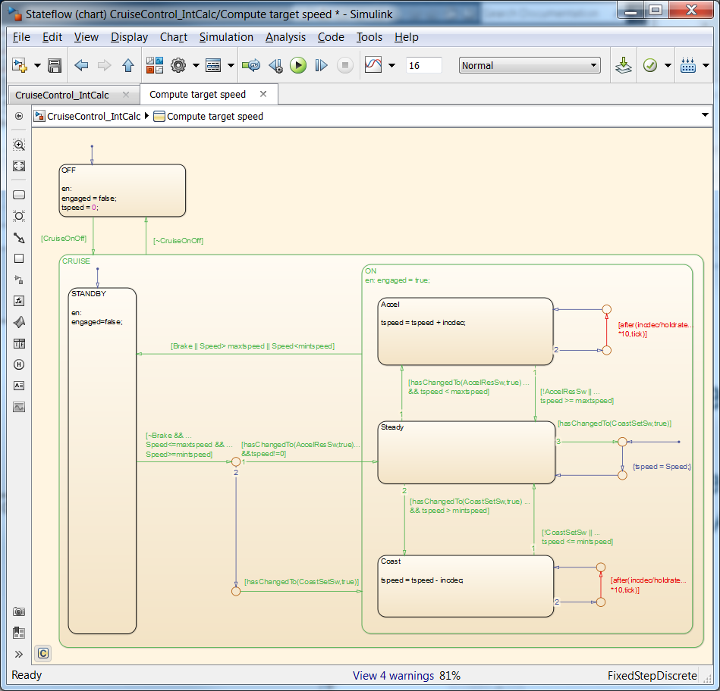
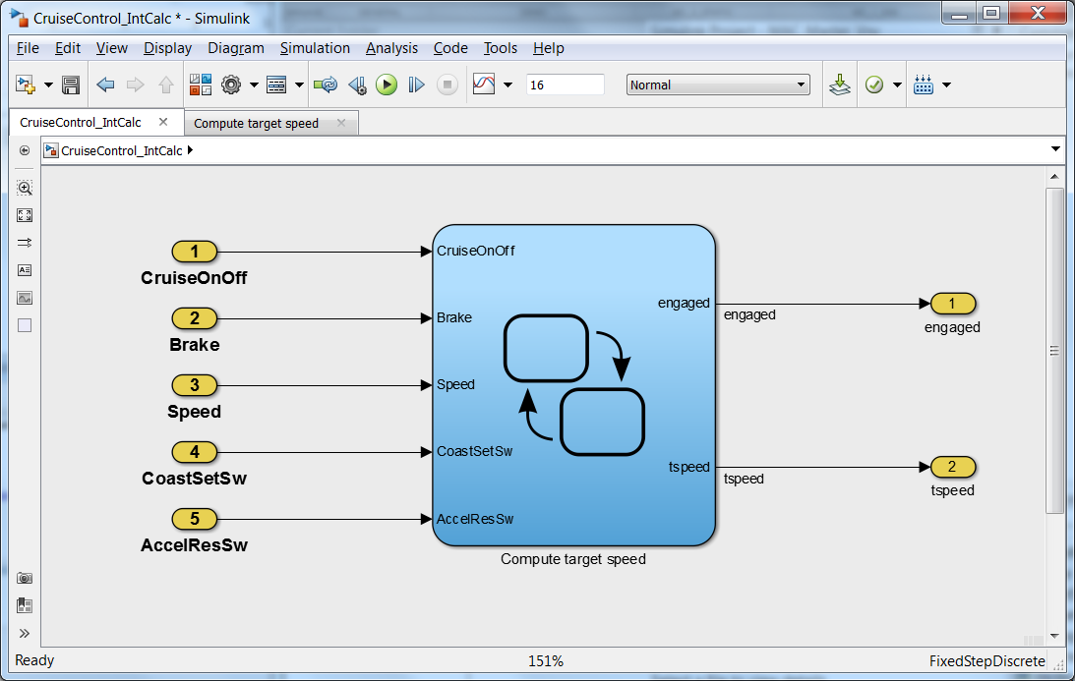
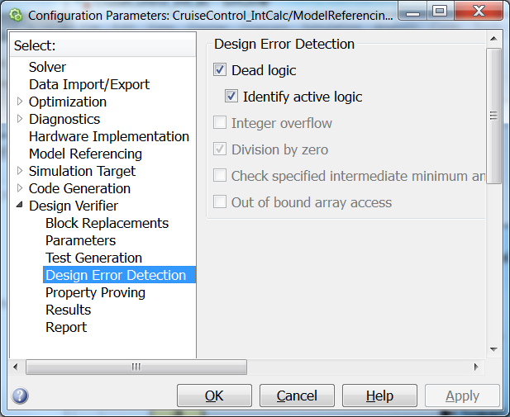
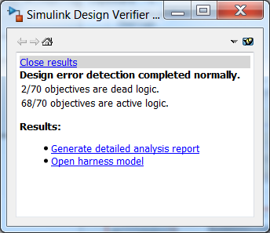
Finding Design Errors: Dead Logic
Simulink Design Verifier identifies “Dead logic” in model
Notes:
Range of calibration constraints

Slide 39
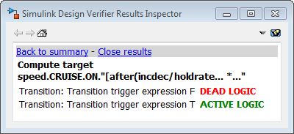
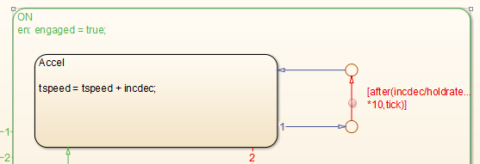
Finding Unintended Behavior
Converting floating-point model to integer calibrations, signals…
Dead logic due to “uint8” operation
Notes:
Range of calibration constraints

Slide 40
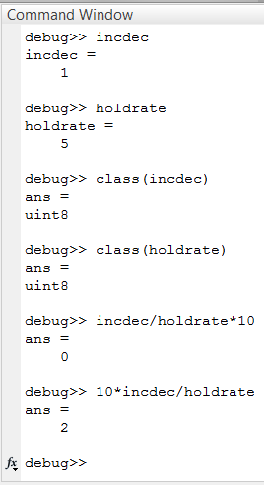
Finding Unintended Behavior
Condition can never be false
Dead logic due to “uint8” operation on incdec/holdrate*10
Fix change the order of operation 10*incdec/holdrate
Notes:
Range of calibration constraints

Slide 41
Increasing Confidence beyond Ad-hoc Testing
Ad-hoc testing is a very useful method but what else do we need to check?
Are all requirements implemented?
Does the implementation follow modeling standards?
Have we shown the absence of design errors (dead logic, divide by zero, overflow)?
Does the implementation pass all functional requirements?
Do the tests completely exercise the implementation?
Does the generated code behave the same as the model?
Can we prove the implementation always meets requirements?
Notes:
NEED TO HIGHLIGHT relevant parts of email. Ask question to room …
Shaun: More “feeling”…. Use an email from Chuck (Snagit)… does this happen to you guys ….
Jay: Chuck: Can we start with this…
Use pic of chuck.

Slide 42
Increasing Confidence beyond Ad-hoc Testing
Ad-hoc testing is a very useful method but what else do we need to check?
Are all requirements implemented?
Does the implementation follow modeling standards?
Have we shown the absence of design errors (dead logic, divide by zero, overflow)?
Does the implementation pass all functional requirements?
Do the tests completely exercise the implementation?
Does the generated code behave the same as the model?
Can we prove the implementation always meets requirements?
Notes:
NEED TO HIGHLIGHT relevant parts of email. Ask question to room …
Shaun: More “feeling”…. Use an email from Chuck (Snagit)… does this happen to you guys ….
Jay: Chuck: Can we start with this…
Use pic of chuck.

Slide 43
Gaining Confidence in our Design
Code equiv & integration checks
Field tests
Functional & structural tests
Confidence
Design error detection
Req Linking
Mdl Advisor
Effort / Time

Slide 44
Gaining Confidence in our Design
Code equiv & integration checks
Field tests
Functional & structural tests
Confidence
Design error detection
Ad-hoc tests
Effort / Time

Slide 45
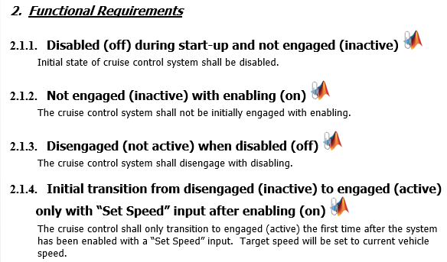
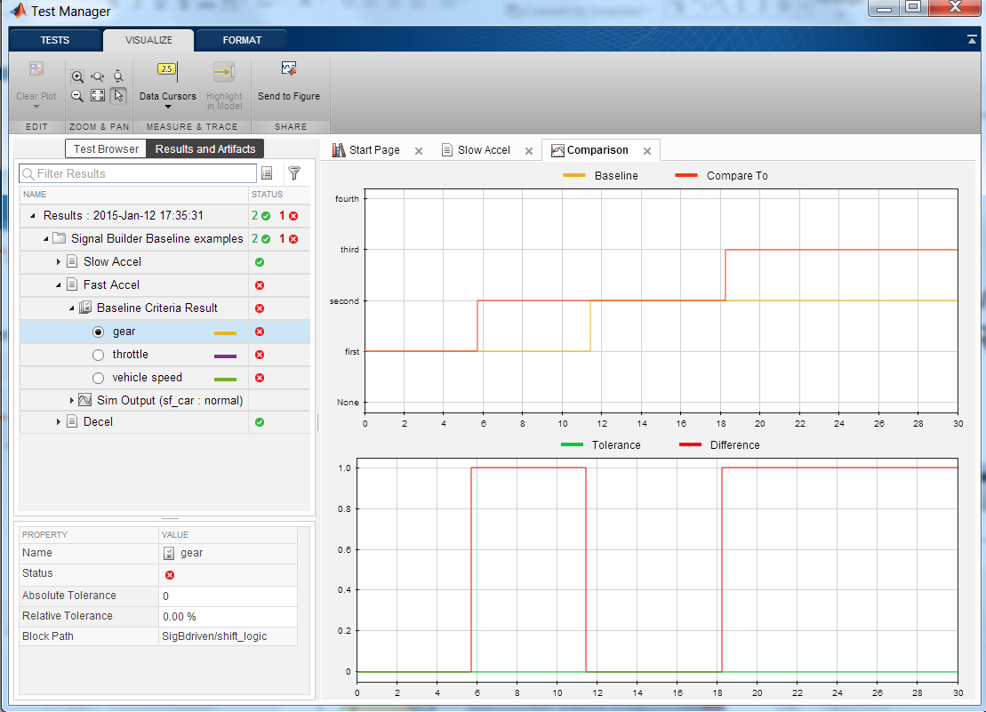
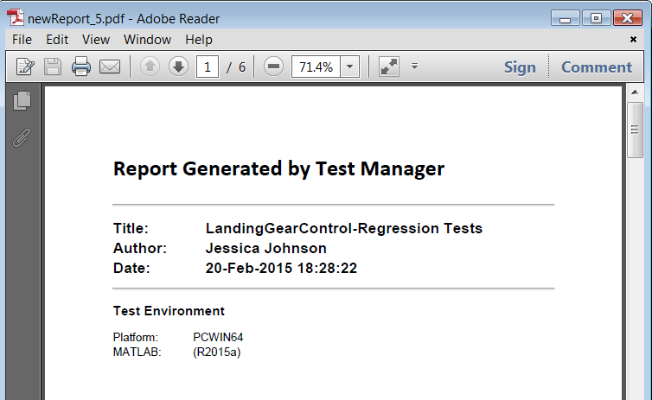
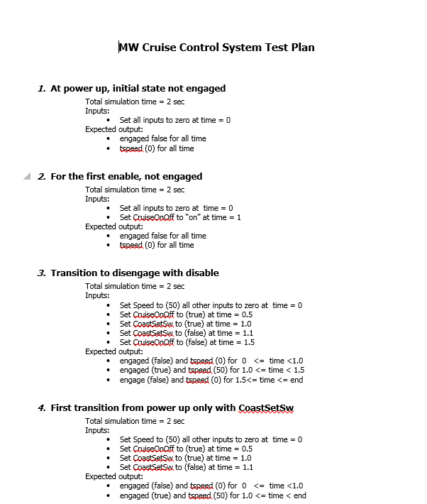



Simulation Testing Workflow
Did we meet our requirements?
Review functional behavior
Requirements
Tests
Design
Functional
Did we completely test our model?
Structural
Structural coverage report
Notes:
Requirements mapped to design. Should we mention? Talk about the linking part.
“design testability” … has the design been fully exercised. Coverage.
“measure test completeness” … coverage report.

Slide 46


Did We Completely Test our Model?
Model Coverage Analysis
Potential causes of less than 100% coverage:
Missing requirements
Over-specified design
Design errors
Missing tests
Notes:
Test completeness of the model and execution paths
Data collected during simulation
to be met, can I check that

Slide 47


Model Coverage: What is Model Coverage?
A quick example…
MC/DC Coverage:
Each condition independently changes the decision outcome
Condition
if (X & Y)
Z = 1;
else
Z = -1;
end
Decision
X
Y
X&Y
MC/DC?
1
1
1
Yes
1
0
0
Yes
0
1
0
Yes
0
0
0
No

Slide 48
Demo Model testing before code generation: Requirements Based Functional Testing with Coverage Analysis

Slide 49







Requirements Based Functional Testing with Coverage Analysis
All 14 requirements based test cases pass
By analyzing model coverage results we find:
Missing test cases for vehicle speed exit conditions, and
Missing requirements (and test cases) for “hold” or continuous speed button input
Notes:
Range of calibration constraints

Slide 50












Functional Testing with Added Requirements & Test Cases
Added 2 new requirements for the “hold” case for speed setting input buttons
Added 5 test cases to the original 14 requirements based test cases
3 test cases for the 2 new requirements
2 test cases for the missing test cases for the vehicle speed exist conditions
4/5 new functional test cases pass
Failed test case showed overshoot beyond target speed limits
Coverage analysis highlighted transitions with design errors
Fixed comparison operators, (<) → (<=), and (>) → (>=)
Now all (19) functional test cases pass with 100% model coverage!
Notes:
Range of calibration constraints

Slide 51





Simulink Test Major Features
Test Manager
Author, execute, manage test cases Review, export, report
Test Manager | Test Harness
Author, execute, manage test cases Review, export, report | Synchronized, simulation test environment
Test Manager | Test Harness | Test Sequence Block
Author, execute, manage test cases Review, export, report | Synchronized, simulation test environment | Test Inputs and assessments Based on logical, temporal conditions
Test Harness
Test Harness
Component under test
Component under test
Main Model
Main Model

Slide 52
Gaining Confidence in our Design
Code equiv & integration checks
Field tests
Functional & structural tests
Confidence
Design error detection
Ad-hoc tests
Effort / Time

Slide 53
Increasing Confidence beyond Ad-hoc Testing
Ad-hoc testing is a very useful method but what else do we need to check?
Are all requirements implemented?
Does the implementation follow modeling standards?
Have we shown the absence of design errors (dead logic, divide by zero, overflow)?
Does the implementation pass all functional requirements?
Do the tests completely exercise the implementation?
Does the generated code behave the same as the model?
Can we prove the implementation always meets requirements?
Notes:
NEED TO HIGHLIGHT relevant parts of email. Ask question to room …
Shaun: More “feeling”…. Use an email from Chuck (Snagit)… does this happen to you guys ….
Jay: Chuck: Can we start with this…
Use pic of chuck.

Slide 54
Increasing Confidence beyond Ad-hoc Testing
Ad-hoc testing is a very useful method but what else do we need to check?
Are all requirements implemented?
Does the implementation follow modeling standards?
Have we shown the absence of design errors (dead logic, divide by zero, overflow)?
Does the implementation pass all functional requirements?
Do the tests completely exercise the implementation?
Does the generated code behave the same as the model?
Can we prove the implementation always meets requirements?
Notes:
NEED TO HIGHLIGHT relevant parts of email. Ask question to room …
Shaun: More “feeling”…. Use an email from Chuck (Snagit)… does this happen to you guys ….
Jay: Chuck: Can we start with this…
Use pic of chuck.

Slide 55
Gaining Confidence in our Design
Code equiv & integration checks
Field tests
Functional & structural tests
Confidence
Design error detection
Req Linking
Mdl Advisor
Effort / Time

Slide 56





Equivalence Testing: Model vs SIL or PIL Mode Testing
Coverage→ 100%
Model
Testing
SIL or PIL
Mode Testing

Slide 57
Demo Testing of the generated code: Test Generation for Full Coverage Equivalence Testing Model vs Code Coverage Comparison

Slide 58








Traceability: Code Generation Report

Slide 59










Test Vector Generation for Equivalence Testing: Adding to Requirements Based Test Coverage

Slide 60





Code Equivalence Check Results: Model vs Code
Re-used full coverage test vectors and harnesses from Model Verification testing
Ran test vectors on generated code using Model Reference SIL mode
Equivalence test performed in Simulink Test, including test execution, evaluation and presentation of the results
Compared Model Coverage to Code Coverage using the integrated support for a code coverage tool in the Code Generation Report
Successfully demonstrated code behavior matches model behavior!

Slide 61



Equivalence Testing: Model vs SIL S-Function Testing

Slide 62
Slide Demo Testing of the generated code: Code Integration Check with Polyspace

Slide 63

Code Integration Check with Polyspace: Dead Code Found in Generated Code
Target speed signal propagated to “CruiseControl.c” [0 … 40]
Maximum target speed parameter = 90
Dead code

Slide 64

Root Cause for Dead Code: Speed Sensor Input Hand Code
Changing analog-to-digital converter from 14 to 12-bit results in dead code
MASK – accounts for scaling down for new ADC from 14-bit to 12-bit
CONV_FACTOR – accounts for translating sensor input counts to mph
Overlooked changing CONV_FACTOR for new ADC
Notes:
You have changed ur ECU for this project. Did not take into account the changes to the scaling factor and the mask that translates input signal (from sensor) into speed for the ECU controller. E.g. frequency of square wave signal from the wheel speed sensor comes. We need to translate that into miles/hr. We did not adapt the scaling factor for Frequency (input) and mask (you only want to read from say the last 12 bits of the register of type uint16 … WHY?).
Previously wheel speed sensor was 0-50,000Hz. Scaling factor is like a conversion factor for translating sensory input to miles/hr. We used a scaling factor of 0.01.
POLYSPACE SHOWS US: Basically there is dead code in my cruise control because of this scaling factor the max speed (designed for 90mph) will max out at 40mph. Speed input to my ECU gets truncated at 40miles/hr (max it will ever go to). 12bits max = 4095 value. Multiply by pre-existing (legacy) scaling of 0.01 = 40.95. My speed will saturate at 40mph.
And masking Speed goes thru manipulations and is being truncated because of the masking issue.
PROBLEM: Ram is the integrator. He put together this architecture. Ran set of test cases on desktop integration (C-code). For 2 out of 10 tests when cruise controller is engaged, when I hit the set button when vehicle’s actual speed is 60mph, the target speed from ECU is unexpected (say 25mph). There does not seem to be an easy correlation of vehicle speed with target speed output.

Slide 65

PolySpaceTM Solution
Formal method: Abstract Interpretation
Green reliable
Green reliable
Proven
Red faulty
Green reliable
Grey dead
Green reliable
Orange unproven
Results are proven for all possible executions of the code!!
Notes:
In practice, PolySpace products will use abstract interpretation to color your source code with green, red, grey and orange.
Green means reliable: the code is correct
Red means faulty each time the operation is reached
Grey is dead code, it’s unreachable
Orange is an unproven check, it can be an error depending on the execution
All these colors are proven for all possible executions of the code

Slide 66
Increasing Confidence beyond Ad-hoc Testing
Ad-hoc testing is a very useful method but what else do we need to check?
Are all requirements implemented?
Does the implementation follow modeling standards?
Have we shown the absence of design errors (dead logic, divide by zero, overflow)?
Does the implementation pass all functional requirements?
Do the tests completely exercise the implementation?
Does the generated code behave the same as the model?
Can we prove the implementation always meets requirements?
Notes:
NEED TO HIGHLIGHT relevant parts of email. Ask question to room …
Shaun: More “feeling”…. Use an email from Chuck (Snagit)… does this happen to you guys ….
Jay: Chuck: Can we start with this…
Use pic of chuck.

Slide 67
Increasing Confidence beyond Ad-hoc Testing
Ad-hoc testing is a very useful method but what else do we need to check?
Are all requirements implemented?
Does the implementation follow modeling standards?
Have we shown the absence of design errors (dead logic, divide by zero, overflow)?
Does the implementation pass all functional requirements?
Do the tests completely exercise the implementation?
Does the generated code behave the same as the model?
Can we prove the implementation always meets requirements?
Notes:
NEED TO HIGHLIGHT relevant parts of email. Ask question to room …
Shaun: More “feeling”…. Use an email from Chuck (Snagit)… does this happen to you guys ….
Jay: Chuck: Can we start with this…
Use pic of chuck.

Slide 68
Gaining Confidence in our Design
Code equiv & integration checks
Field tests
Functional & structural tests
Confidence
Design error detection
Req Linking
Mdl Advisor
Issues were identified and fixed with each test but …
Field testing will show the algorithm still had issues
Effort / Time
Notes:
I understand that building systems is all about gaining confidence… how do I know whether I have done enough?
Are we missing requirements?
Do the test vectors adequately cover requirements?
How about unintended interaction of calibration parameters?
Min max is on signal range … not on parameter ranges normally.
Mention requirements, and say these are derived from requirements …
Define model coverage == tests cover every part of design. (E.g. of decision coverage – that way it can connect to the HTML coverage report you have in video)
====== DO NOT EDIT BELOW ==========
Demos we will show
When we went from floating to fixed … we got dead code .. Slide about inccalc. CruiseControl_IntCalc.slx … show CruiseControl_IntCalc_harness as well.
Arrow guy slide
DEMO: Bring up SL Test. Bring in test cases, show inbuilt functional output expected (waveform – data cursors/SDI within SL Test), and measure coverage. Now there is missing coverage … is this due to a missing requirement (pick something – CHUCK). … What should we do now, mention our options, but go ahead and import from Excel. Now everything is 100% (just bring up coverage report, don’t rerun tests) … SHOW SIL mode from within SL Test.
Come back to arrow guy slide … now generate code …
DEMO: Polyspace .. Bring up PS pre-run results… talk about colors. Show the fix within IFDEF … and show pre-run PS results with Fix.
Arrow slide
Slide on prop
DEMO: on field issue. Show fix. Run SLDV again. [Voice over that you may want to run tests again]
DEMO: Also, let’s see if we can ensure that this would never happen again, ie. Generalize property on on requirements.
Summarize marketing slide

Slide 69
Gaining Confidence in our Design
Code equiv & integration checks
Field tests
Functional & structural tests
Confidence
Design error detection
Req Linking
Mdl Advisor
Effort / Time
Notes:
I understand that building systems is all about gaining confidence… how do I know whether I have done enough?
Are we missing requirements?
Do the test vectors adequately cover requirements?
How about unintended interaction of calibration parameters?
Min max is on signal range … not on parameter ranges normally.
Mention requirements, and say these are derived from requirements …
Define model coverage == tests cover every part of design. (E.g. of decision coverage – that way it can connect to the HTML coverage report you have in video)
====== DO NOT EDIT BELOW ==========
Demos we will show
When we went from floating to fixed … we got dead code .. Slide about inccalc. CruiseControl_IntCalc.slx … show CruiseControl_IntCalc_harness as well.
Arrow guy slide
DEMO: Bring up SL Test. Bring in test cases, show inbuilt functional output expected (waveform – data cursors/SDI within SL Test), and measure coverage. Now there is missing coverage … is this due to a missing requirement (pick something – CHUCK). … What should we do now, mention our options, but go ahead and import from Excel. Now everything is 100% (just bring up coverage report, don’t rerun tests) … SHOW SIL mode from within SL Test.
Come back to arrow guy slide … now generate code …
DEMO: Polyspace .. Bring up PS pre-run results… talk about colors. Show the fix within IFDEF … and show pre-run PS results with Fix.
Arrow slide
Slide on prop
DEMO: on field issue. Show fix. Run SLDV again. [Voice over that you may want to run tests again]
DEMO: Also, let’s see if we can ensure that this would never happen again, ie. Generalize property on on requirements.
Summarize marketing slide

Slide 70
Field Test Results: Has something like this happened to you?
From: Larry Findebug Sent: Monday, March 2, 2015 9:29 PM To: Chuck Olosky Subject: Cruise Control Target Speed Issue
I ran into an unexpected issue with the new Cruise Control feature during vehicle testing.
While going downhill, random target speed increases with “reduce speed” button
I set the target speed while going downhill on the track going around 40 mph
While pulsing the “reduce speed” button, target speed reduced to 20 mph limit
Next time I hit “reduce speed”, it increased the target speed from 20 mph to 33 mph
Another time it increased the target speed from 20 mph to 29 mph
Hopefully we can fix this issue quickly. These issues that don’t repeat themselves can be hard to find. Let me know if I can help. ---Larry F
While going downhill, target speed increases with “reduce speed” button

Slide 71
Field Tests Uncover Issue
Problem: While going downhill, target speed increases with “reduce speed” button and assumes random values
Functional tests pass for model
Completely tested the model (100% coverage achieved)
Nominal signal and parameter values worked in simulation
Notes:
Handoff to Chuck at end of slide.
NV: keep abreast of steps.

Slide 72
How can debug the issues found in the field?
Reproduce field issue in Simulink
Use field calibration values
Set inputs manually or replay data if it exists
But this is just “one” more test case that covers a subset of all possible input ranges, sequences and calibration values
Already have requirements based test vectors, 100% coverage, and all passed
How do I know that this will not happen with a different set of conditions?
Road conditions
Driver inputs
Calibration values
Sequence of events
Notes:
NEED TO HIGHLIGHT relevant parts of email. Ask question to room …
Shaun: More “feeling”…. Use an email from Chuck (Snagit)… does this happen to you guys ….
Jay: Chuck: Can we start with this…
Use pic of chuck.

Slide 73

Use Model-Based Design to Reproduce Field Issue…
Construct a model of field issue for Simulink Design Verifier
Constrain inputs to represent field issue
Create model of field issue behavior
Ask tool to prove whether errant condition can occur
Notes:
Add the property fix.
Point to logic that broke.
Then show what you did …
Ask SLDV the following questions:
Can “XXX” ever occur?
Is “XXX” always met by my model?
Do you expect my calibrators to be doing this?

Slide 74

Field Issue Behavior Model Target speed increases with “reduce speed” button
I set the target speed to the vehicle speed (40 mph) while going downhill on the track
I was pulsing the “reduce speed” button until it decreased the target speed to the 20 mph limit
The next time I hit the “reduce speed” button it increased the target speed from 20 mph to 33 mph
Notes:
Identify Failure in Model with Simulink Design Verifier
Are this simply blocks in Simulnk?

Slide 75
Demo Formal verification with property proving: Reproducing Field Issues Requirements “property” models Checking more conditions

Slide 76











Reproducing Field Issues
targetSpeed
targetSpeed
Recreated the field issue
Constrained inputs to match field inputs
Modeled field issue behavior as a property
Property Proving generated a test case that reproduced the field issue
Generated harness was used to debug and demonstrate the fix
CoastSetSw
CoastSetSw
AccelResSw
AccelResSw
Notes:
Range of calibration constraints

Slide 77
















Proving Model will Meet Requirements
targetSpeed
Modeled requirement as a Property model
Unconstrained inputs
Modeled intended requirement behavior
Property Proving generated a test case that violated the requirement
Found unintended behavior when both “speed change” buttons pressed
Added algorithm to reject double press inputs
Proved model now meets this requirement!
targetSpeed
CoastSetSw
CoastSetSw
AccelResSw
AccelResSw
Notes:
Range of calibration constraints

Slide 78

engaged
Exp_engaged
targetSpeed
Exp_targetSpeed

Slide 79



















Proving Model will Meet Requirements over the Calibration Range
targetSpeed
=2
targetSpeed
Added a sweep of possible calibration values to requirement property model
Property Proving generated a test case that violated the requirement
Found unintended behavior with an “incdec” value of (2)
Added a limit check to the speed change algorithm
Proved model now meets this requirement over the range of calibration values!
CoastSetSw
CoastSetSw
AccelResSw
AccelResSw
Notes:
Range of calibration constraints

Slide 80



Re-run Functional Tests after Property Proving Fixes
Partial model coverage for “RejectDoublePress”
Requirements and test cases need to be updated

Slide 81
Property Proving Work Summary
Use “Property Proving” to prove the algorithm will always perform with the intended behavior
Construct the Property Proving Model to reflect the requirement or field issue
Model the intended or observed behavior
Constrain the signal inputs per requirement or field issue
Sweep or constrain the calibrations range
If property is falsified (disproved)
Use the Design Verifier generated harness to debug issue, then discard harness
Re-run Property Proving to verify the fix
In the example, we showed an iterative workflow to improve confidence
“Sneak path” due to incomplete refactoring of the model
A more general “reduce speed” property showed a simultaneous input issue
Sweeping with all possible calibration values showed a limit check issue

Slide 82
Verification Design Space: Increasing the Coverage beyond Simulation
SIMULATION TESTING
FORMAL VERIFICATION (Ideal case)
FORMAL VERIFICATION (Real-world)
*
*
*
*
*
*
*
*
*
Design Space
*
*
*
*
*
*
Point coverage of design space through simulation
Verifies correct behavior for these points of the design space
All operating conditions
All input levels and sequences
All possible calibration values
Complete coverage of design space
All possible model behaviors are correct
Real-world application of formal verification
Based on completeness of behavior models
By using formal verification methods…
Simulink Design Verifier proves correct behaviors over a larger amount of the design space
Notes:
Need for formal verification
In order to understand the need for formal verification, lets contrast it to traditional testing methodologies.
In a typical testing framework, we create test inputs to test certain points in our design. These tests could be for functional design points, but in essence we can only hope to test certain (finite) points in the design space. There is a limit to the total design space we can cover in this methods.
In contrast, formal verification lets you achieve 100% coverage of the design space using mathematical techniques – an ideal case. By doing so, we can hope to test a wider part of our design and find flaws and unexpected/unintended parts of our design.
However, note that in practice covering the entire design space may not be feasible – either due to design complexity, nonlinearities, formal engine limitations, time constraints etc. In a practical approach, we do however get much higher confidence (by testing more of the design space) and hence the approach fairs better than traditional point-based testing solutions.

Slide 83
Increasing Confidence beyond Ad-hoc Testing
Ad-hoc testing is a very useful method but what else do we need to check?
Are all requirements implemented?
Does the implementation follow modeling standards?
Have we shown the absence of design errors (dead logic, divide by zero, overflow)?
Does the implementation pass all functional requirements?
Do the tests completely exercise the implementation?
Does the generated code behave the same as the model?
Can we prove the implementation always meets requirements?
Notes:
NEED TO HIGHLIGHT relevant parts of email. Ask question to room …
Shaun: More “feeling”…. Use an email from Chuck (Snagit)… does this happen to you guys ….
Jay: Chuck: Can we start with this…
Use pic of chuck.

Slide 84
Increasing Confidence beyond Ad-hoc Testing
Ad-hoc testing is a very useful method but what else do we need to check?
Are all requirements implemented?
Does the implementation follow modeling standards?
Have we shown the absence of design errors (dead logic, divide by zero, overflow)?
Does the implementation pass all functional requirements?
Do the tests completely exercise the implementation?
Does the generated code behave the same as the model?
Can we prove the implementation always meets requirements?
Notes:
NEED TO HIGHLIGHT relevant parts of email. Ask question to room …
Shaun: More “feeling”…. Use an email from Chuck (Snagit)… does this happen to you guys ….
Jay: Chuck: Can we start with this…
Use pic of chuck.

Slide 85
Gaining Confidence in our Design
Code integration checks
Field tests
Requirement proofs
Functional & structural tests
Confidence
Design error detection
Tests entire specified range of input signals and calibrations
Ensures implementation will always meet requirements
Generates a test case upon failure for debugging
Increases design confidence
Req Linking
Mdl Advisor
Effort / Time
Notes:
I understand that building systems is all about gaining confidence… how do I know whether I have done enough?
Are we missing requirements?
Emphasize value from doing stuff early. Consider something to drive home that point.
Is ad-hoc testing adding that much value.
Have the “requirements proofs” to black.
Do the test vectors adequately cover requirements?
How about unintended interaction of calibration parameters?
Min max is on signal range … not on parameter ranges normally.
Mention requirements, and say these are derived from requirements …
Define model coverage == tests cover every part of design. (E.g. of decision coverage – that way it can connect to the HTML coverage report you have in video)
====== DO NOT EDIT BELOW ==========
Demos we will show
When we went from floating to fixed … we got dead code .. Slide about inccalc. CruiseControl_IntCalc.slx … show CruiseControl_IntCalc_harness as well.
Arrow guy slide
DEMO: Bring up SL Test. Bring in test cases, show inbuilt functional output expected (waveform – data cursors/SDI within SL Test), and measure coverage. Now there is missing coverage … is this due to a missing requirement (pick something – CHUCK). … What should we do now, mention our options, but go ahead and import from Excel. Now everything is 100% (just bring up coverage report, don’t rerun tests) … SHOW SIL mode from within SL Test.
Come back to arrow guy slide … now generate code …
DEMO: Polyspace .. Bring up PS pre-run results… talk about colors. Show the fix within IFDEF … and show pre-run PS results with Fix.
Arrow slide
Slide on prop
DEMO: on field issue. Show fix. Run SLDV again. [Voice over that you may want to run tests again]
DEMO: Also, let’s see if we can ensure that this would never happen again, ie. Generalize property on on requirements.
Summarize marketing slide

Slide 86
Gaining Confidence in our Design
Code integration checks
Field tests
Requirement proofs
Functional & structural tests
Confidence
Design error detection
Tests entire specified range of input signals and calibrations
Ensures implementation will always meet requirements
Generates a test case upon failure for debugging
Increases design confidence
Ad-hoc tests
Effort / Time
Notes:
I understand that building systems is all about gaining confidence… how do I know whether I have done enough?
Are we missing requirements?
Emphasize value from doing stuff early. Consider something to drive home that point.
Is ad-hoc testing adding that much value.
Have the “requirements proofs” to black.
Do the test vectors adequately cover requirements?
How about unintended interaction of calibration parameters?
Min max is on signal range … not on parameter ranges normally.
Mention requirements, and say these are derived from requirements …
Define model coverage == tests cover every part of design. (E.g. of decision coverage – that way it can connect to the HTML coverage report you have in video)
====== DO NOT EDIT BELOW ==========
Demos we will show
When we went from floating to fixed … we got dead code .. Slide about inccalc. CruiseControl_IntCalc.slx … show CruiseControl_IntCalc_harness as well.
Arrow guy slide
DEMO: Bring up SL Test. Bring in test cases, show inbuilt functional output expected (waveform – data cursors/SDI within SL Test), and measure coverage. Now there is missing coverage … is this due to a missing requirement (pick something – CHUCK). … What should we do now, mention our options, but go ahead and import from Excel. Now everything is 100% (just bring up coverage report, don’t rerun tests) … SHOW SIL mode from within SL Test.
Come back to arrow guy slide … now generate code …
DEMO: Polyspace .. Bring up PS pre-run results… talk about colors. Show the fix within IFDEF … and show pre-run PS results with Fix.
Arrow slide
Slide on prop
DEMO: on field issue. Show fix. Run SLDV again. [Voice over that you may want to run tests again]
DEMO: Also, let’s see if we can ensure that this would never happen again, ie. Generalize property on on requirements.
Summarize marketing slide

Slide 87
Key Enablers
MathWorks tools enable …
The usage of a standard workflow for software development
A seamless, integrated workflow for model development, code generation and V&V testing
Design verification earlier in the development lifecycle and support across the lifecycle
Increased confidence in the work product with integrated support for code verification

Slide 88
Thank You!

Slide 89
Standard Workflow

Slide 90
Model Based Design Verification Workflow
Model Verification
Code Verification
Discover design errors at design time
Gain confidence in the generated code
Performed ad-hoc simulation testing
Linked requirements to model and tests
Performed functional testing
Measured model coverage
Enforced modeling standards with Model Advisor
Found defects early with Design Error Detection

Slide 91
Model Verification Summary
Traceability
Requirements linking to blocks, states, transitions, MATLAB code
Navigation and reporting of Requirements ←→ Model
Enforcing Model Standards (Static Testing)
Automated model checking with standard or custom checks
Interactive fixing workflow with reports for model reviews
Design Error Detection
Automated, static check for divide by zero, overflow, dead logic
Increase confidence in the design
Requirements based Functional Testing
Automated creation of test harnesses and entry of test vectors
Model coverage analysis to show design & test completeness
Property Proving
Model requirements with property blocks
Attempt to violate property to demonstrate robustness
Earlier testing to deliver higher quality software throughout the workflow

Slide 92
Model Verification Products
Simulink Verification & Validation
Traceability
Enforcing Model Standards
Model Coverage
Simulink Design Verifier
Test Vector Generation
Design Error Detection
Property Proving

Slide 93
Code Verification in Model Based Design
Model Verification
Code Verification
Discover design errors at design time
Gain confidence in the generated code
Traced from code to model with Code Generation Report
Compared model coverage to code coverage with the integrated 3rd party tool
Performed Equivalence Testing using the integrated SIL mode
Checked the integrated code for run-time errors

Slide 94
Code Verification Summary
Traceability
Code generation report
Complete traceability: Requirements ←→ Model ←→ Code
Test Vector Generation
Increase coverage beyond requirements testing
Complete model coverage for equivalence testing
Equivalence Testing
Re-use of high coverage model test vectors in SIL mode
Automated SIL testing, save to Simulation Data Inspector
Model vs Code output comparison
Unintended Functionality
Re-use of high coverage model test vectors in SIL mode
Integrated 3rd party code coverage tool
Results in code generation report, Model vs Code coverage comparison
Increasing confidence in the work product by with integrated code verification support and reuse of Model Verification test assets in an automated workflow

Slide 95
Code Verification Products
Embedded Coder
Traceability
Equivalence Testing
Prevention of Unintended Functionality, with an integrated 3rd party code coverage tool
Simulink Design Verifier
Test Vector Generation

Slide 96


Software-in-the-Loop (SIL) Testing: Verify Production Controller with Software-in-the-loop
Code
Generation
Execution
Host/Host
Nonreal-time
Compiled C Code
S-Function
(Windows DLL)
Notes:
>> sbr_testHarness_SiL

Slide 97



Processor-in-the-Loop Testing: Verify Production Controller with Processor-in-the-loop
Code
Generation
Execution
Host/Target
Nonreal-time
Production Processor
Notes:
Embedded IDE Link for TS has been used(C167)
>> sbr_testHarness_PiL

Slide 98
Support

Slide 99
Model Verification Products Timeline
Requirements Mgmt Interface R11.1 (1999)
Model Coverage Tool R12 (2000)
Simulink Verification and Validation R14 (2004)
Simulink Test R2015a
Simulink Design Verifier R2007a
2010
2011
2012
2013
2006
2007
2008
2009
1999
2000
2001
2002
2003
2004
2005
2014
2015
Embedded Coder R12 (2000)
IEC Certification Kit R2009a
IEC Certification Kit with ISO 26262 R2011a

Slide 100

Documentation
>> doc slvnv

Slide 101

Documentation
>> doc sldv

Slide 102

Documentation
>> doc sltest

Slide 103

Product Page – Simulink Verification & Validation
http://www.mathworks.com/products/simverification/

Slide 104

Product Page – Simulink Design Verifier
http://www.mathworks.com/products/sldesignverifier/

Slide 105

Product Page – Simulink Test
http://http://www.mathworks.com/products/simulink-test//

Slide 106

Solutions Page
http://www.mathworks.com/verification-validation/

Slide 107

MATLAB Central
File Exchange
Download free files
Over 10K available – including functions, apps, examples, and models
MATLAB Answers
Ask programming questions
Search 18K+ existing answers
Cody
Challenge and expand your knowledge of MATLAB
Blogs
Read commentary from MathWorks engineers who design, build, and support MATLAB and Simulink
http://www.mathworks.com/matlabcentral/
Notes:
MATLAB Central is the home of the MathWorks user community, where users can ask and get answers to their questions about MathWorks products. This area of the MathWorks Web site supports idea-sharing and collaboration among users. Resources include a very active file exchange service with over 12,500 user-contributed functions, examples, and other submissions. MATLAB Central also provides convenient Web access to the Usenet newsgroup comp.soft-sys.matlab (affectionately called “CSSM”), where users share ideas, tips and tricks, example code, and viewpoints.
MATLAB Central:
averaging 200 submissions per month
380,000 downloads per month
MATLAB Answers
Search for and rate answers to programming questions in a collaborative question and answer environment
averaging 120 new questions and 685 new answers posted every day
Comment on, contribute, or vote up answers, building reputation as you go
For more information, refer to mathworks.com/matlabcentral.

Slide 108


http://www.mathworks.com/services/training/courses/
Notes:
The MathWorks Training Services helps you use our products to succeed in your work. Our training courses are developed around the core responsibilities of engineers, scientists and educators like you. Our trainers focus on your goals and how to utilize MathWorks tools to achieve them.
Public Instructor-led Training Public instructor-led courses are offered in North America, France, Germany, Italy, Spain, Switzerland, the Netherlands and the United Kingdom. In addition, many of our distributors offer training at other international sites. So, whether you are in Boston, München , or Bangalore, you can find hands-on training at a location near you.
On-Site Instructor-led Training
The MathWorks also offers customized training courses that can be taught at your own facility. Our engineers can incorporate company- or industry-specific examples into a curriculum of your choosing.
Instructor-led E-Learning All of our training courses (except for a few that require specialized hardware) are also offered over the Web. An instructor in one of our offices can share their desktop with you and communicate over the phone. You get the same high quality instruction, but in the convenience of your home or office. Our e-learning courses are also typically run with far fewer students, with a more flexible schedule.
Course Topics
The MathWorks offers introductory and intermediate courses in MATLAB, Simulink and Stateflow, as well as advanced courses in subjects such as control design, signal and image processing, test and measurement, optimization, statistics and financial analysis.
For course information and the latest training schedule and locations:
www.mathworks.com/training

Slide 109
Consulting Process Related Services by Stage of Adoption
Consulting advisory services is
customizable based on customer requirements
Customer Profile:
Has established Model-Based Design for production project
Production usage of code generation
Some level of formalized verification workflow
Wants to update to an ISO compliant process
Process and Technology Standardization
Customer Profile:
Use MBD for algorithm development & rapid prototyping
Use traditional hand code method
No formalized verification workflow (with model)
Wants to transition to Model-Based Design development workflow
Model-Based Design Maturity
Process Deployment Advisory Services including ISO 26262
Expanded Rollout
Target Specific Process Establishment Advisory Services
Department Rollout
Project Rollout
Initial Adoption
Explore
Expand
Standardize

Slide 110
Background

Slide 111
Benefits of Model Based Design (MBD) …
Following a model based design process increases confidence in the design
Design errors can be found and fixed early in the process, close to when they happen
Model Based Design
Facilitates early testing
Enables higher quality software throughout the workflow
Delivers tested, auto-coded work products

Slide 112



Design Error Detection with Simulink Design Verifier
Dead logic
Division by zero
Range violation
Integer overflow
Assertion violation
Out of bound array access
Detect hard-to-find design errors before simulation
Notes:
Verification can be done early in the design phase – at a model level using the formal methods. A number of potential design problems can be detected automatically, before running simulation and before testing.

Slide 113
Simulink Test Tool for authoring, managing, and executing simulation-based tests
Test Harnesses
Synchronized testing environment
Enables unit testing without requiring new model
Component or system
Configure, build, simulate
Supports SIL, or PIL
Supports direct “adhoc” testing
Test Harness
Exercise
Component under test
Analyze
synchronized
Main Model

Slide 114
Simulink Test Tool for authoring, managing, and executing simulation-based tests
Test Sequence Block
MATLAB Action Language
Steps are temporal or logic-based
Create complex test inputs and assessments
Trouble shooting aids
“Formerly referred to as the reactive testing block”
Test Sequence/Assessment Block

Slide 115
Simulink Test Tool for authoring, managing, and executing simulation-based tests
Test Manager
Create Test Cases
Group into Suites and Test Files
Execute individual or batch
View summary and detailed results
Archive, export, report

Slide 116


Test Case Templates
1. Simulation Test
Input
Output
Assessment Criteria
2. Baseline Test
Input
Output
Assessment Criteria
File
Expected
Outputs
3. Equivalence Test
Input
Output
Input
Output
Assessment Criteria

Slide 117
Demo Test case generation: Reproducing Field Issues

Slide 118
Timely, automated, Is there a tool/method to help me debug these field issues and test more operating conditions?
“Design Error Detection” function of Simulink Design Verifier
Analyzed the model over ranges of inputs and calibration
Found dead logic and divide by zero
Automated, easy, just a few mouse clicks
Requirements for the tool
Then go to demo, don’t over-explain why or how
Let’s take a look at the “Property Proving” function Simulink Design Verifier
Based on modeling requirements
Model expected behavior along with input constraints
Instead of requirement alone, include the known field conditions and observed behavior
See if it can find the issue, if it can it will give us a test cases for debugging
Upfront work
In the past, Req Func Ver was good enough
Needed to deliver for vehicle testing
Notes:
NEED TO HIGHLIGHT relevant parts of email. Ask question to room …
Shaun: More “feeling”…. Use an email from Chuck (Snagit)… does this happen to you guys ….
Jay: Chuck: Can we start with this…
Use pic of chuck.

Slide 119




Use Formal Verification to Reproduce the Field Issue: Identify Failure Mode in Model
Construct a “property” for Simulink Design Verifier
Leverage Calibration parameter values from field test
Ask tool to prove whether errant condition can occur
Use generated test case to debug
Re-usable to prove correct behavior
Always true
Controls
Model
Verification Logic
Evaluated 2nd
Used the Property Proving feature of Simulink Design Verifier
Notes:
Add the property fix.
Point to logic that broke.
Then show what you did …
Ask SLDV the following questions:
Can “XXX” ever occur?
Is “XXX” always met by my model?

Slide 120
Formal Verification vs. Simulation Testing
Design Space
Design Space
Design Space
*
*
*
*
*
*
*
*
*
*
*
*
*
*
*
*
*
*
*
*
*
*
SIMULATION TESTING
FORMAL VERIFICATION (Ideal case)
FORMAL VERIFICATION* (Real-world)
Point coverage through simulation
Complete coverage of design space (formal proof)
Real-world application of formal verification
* Source: Erik Seligman, “Formal Verification – An Overview”
Notes:
Need for formal verification
In order to understand the need for formal verification, lets contrast it to traditional testing methodologies.
In a typical testing framework, we create test inputs to test certain points in our design. These tests could be for functional design points, but in essence we can only hope to test certain (finite) points in the design space. There is a limit to the total design space we can cover in this methods.
In contrast, formal verification lets you achieve 100% coverage of the design space using mathematical techniques – an ideal case. By doing so, we can hope to test a wider part of our design and find flaws and unexpected/unintended parts of our design.
However, note that in practice covering the entire design space may not be feasible – either due to design complexity, nonlinearities, formal engine limitations, time constraints etc. In a practical approach, we do however get much higher confidence (by testing more of the design space) and hence the approach fairs better than traditional point-based testing solutions.

Slide 121
Adding Property Proving to the Testing Process …
Tests for the entire specified range of input signals
Tests for the entire specified range of calibration values
Can use Property models based on requirements
Can use Property models that include field conditions
Proves if the implementation can violate a property, or fail to meet a requirement
Generates a test case for debugging the issue
Can re-use the Property models for the next controls version
Increases design confidence beyond requirements based, dynamic testing

Slide 122
Demo Formal verification with property proving: Requirements “property” models Checking more conditions

Slide 123
Adding Property Proving & Test Generation to the Testing Process …
Tests the entire specified range of input signals and calibration values
Proves implementation will always meet requirements
Generates a test case upon failure for debugging
Increases design confidence

